Slide 1


Welcome to St Mary’s Old Swinford.
We hope that whoever you are you will find comfort in following this pilgrimage around St Mary’s church. If you would like to talk to a member of clergy or find out more information about the church please follow the links on the contact us page and we will get in touch. Press the enter button on your keyboard when you are ready to move to the next slide.

Slide 2
Map of locations for pilgrimage within the church.
Lady Chapel
South
7
8
10
9
5
Pews
East
West
6
4
3
Pews
1
2
Narthex
Sanctuary
Porch
North

Slide 3
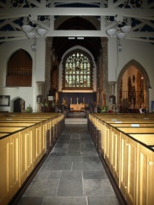
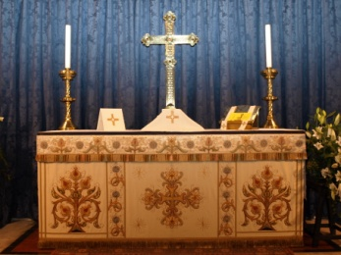
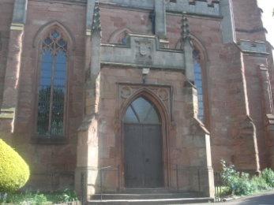
You might like to sit and look at the photograph on the next slide consciously putting down the things that you carry with you as you visualise yourself sitting in St Mary’s.
Reflection – be conscious of the things that you carry today – they may be things for which you are grateful or areas that are troubling you. Ask God to journey with you as you move around this lovely old building.

Slide 4
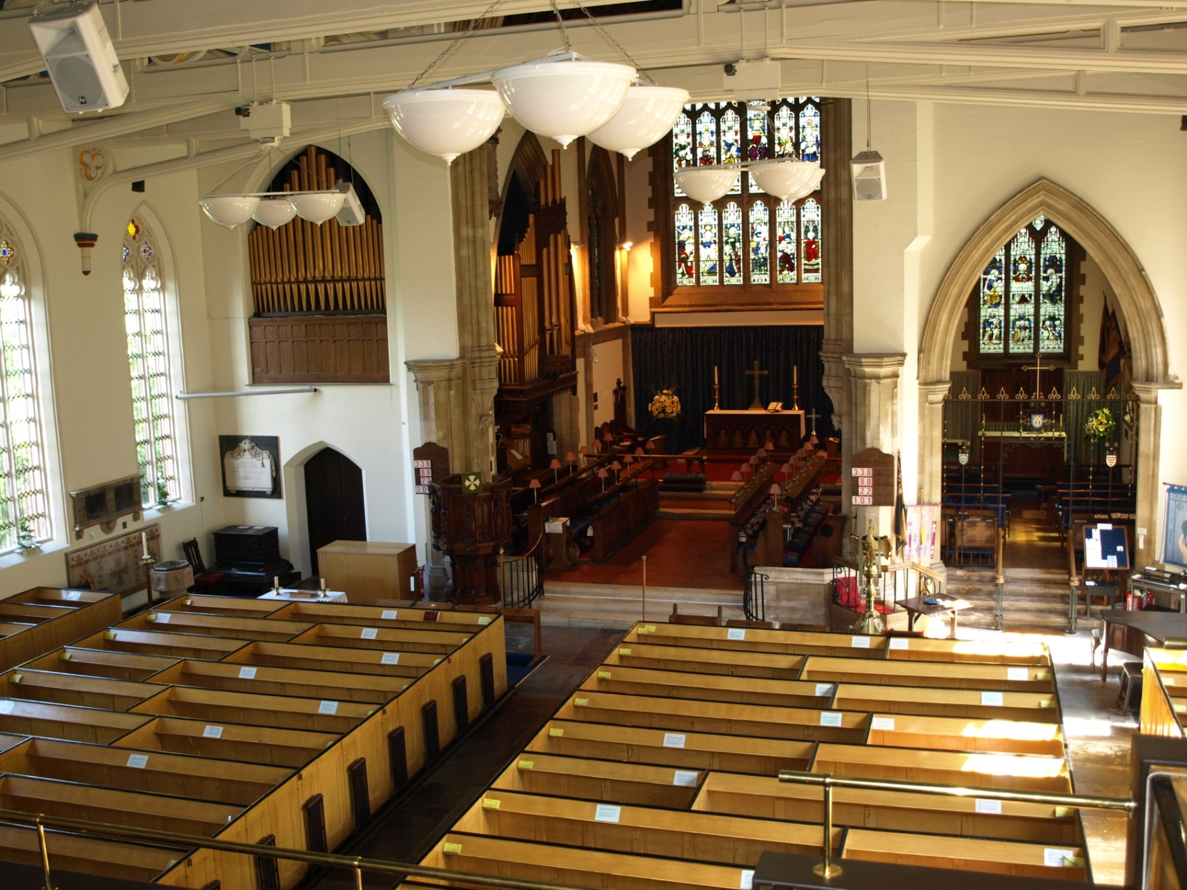

Slide 5
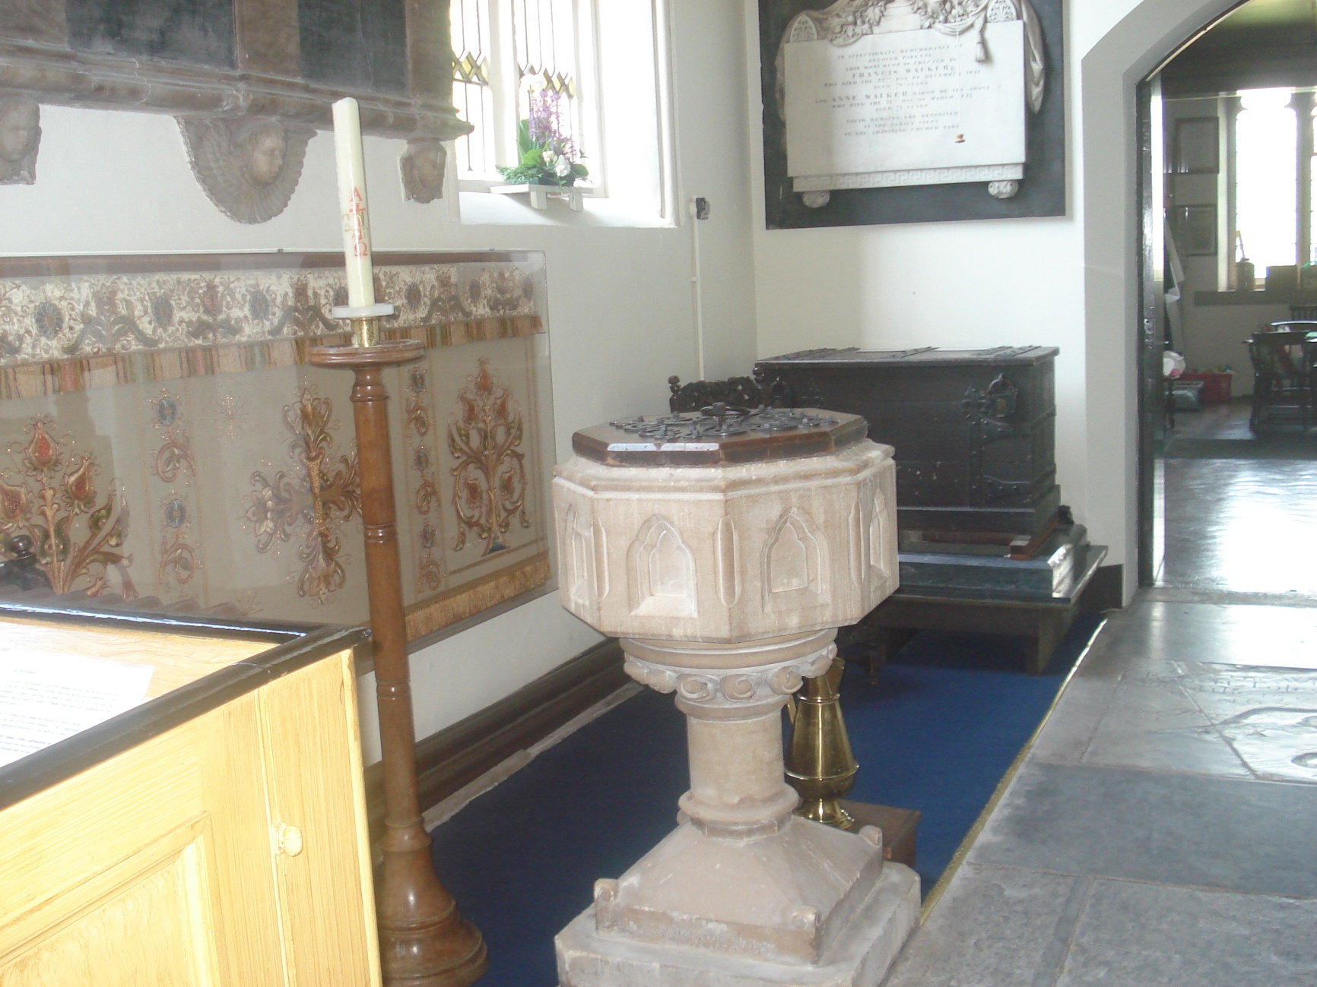
The font.
At this place people are baptised into the church. It is a place of belonging. It is also a place where promises are made to follow Jesus Christ and to live his way; the font is a place of cleansing where we are asked to turn to Christ and to begin to understand that he loves and forgives us.
Reflection – think about what it means to you to belong. You may want to give thanks for your Christian journey so far or express your desire to begin again or move on in that journey.

Slide 6
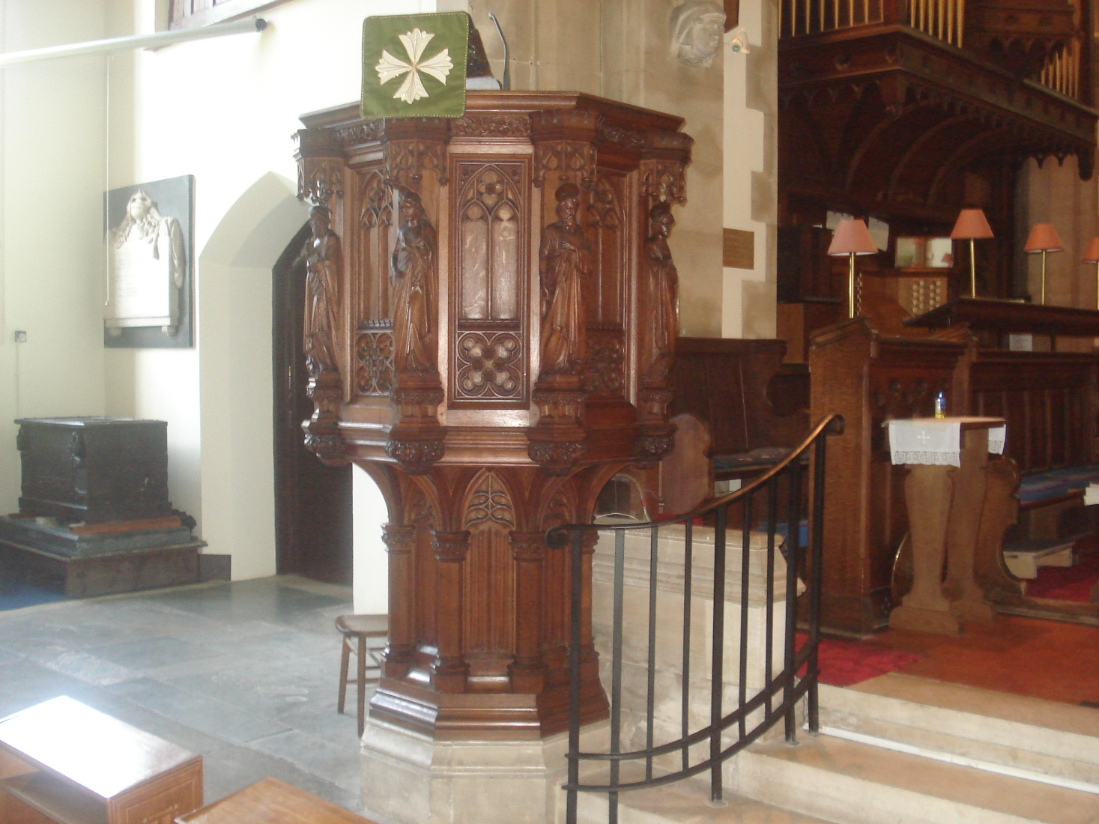
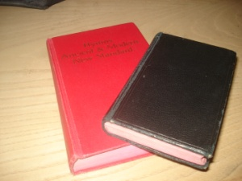
The pulpit.
From here we listen to someone speak about God using the text of the day.
Reflection – think about the people who have influenced for good through their example or their teaching such as a teacher, a parent or family friend. You might need to put down something which has not helped your journey through life.

Slide 7
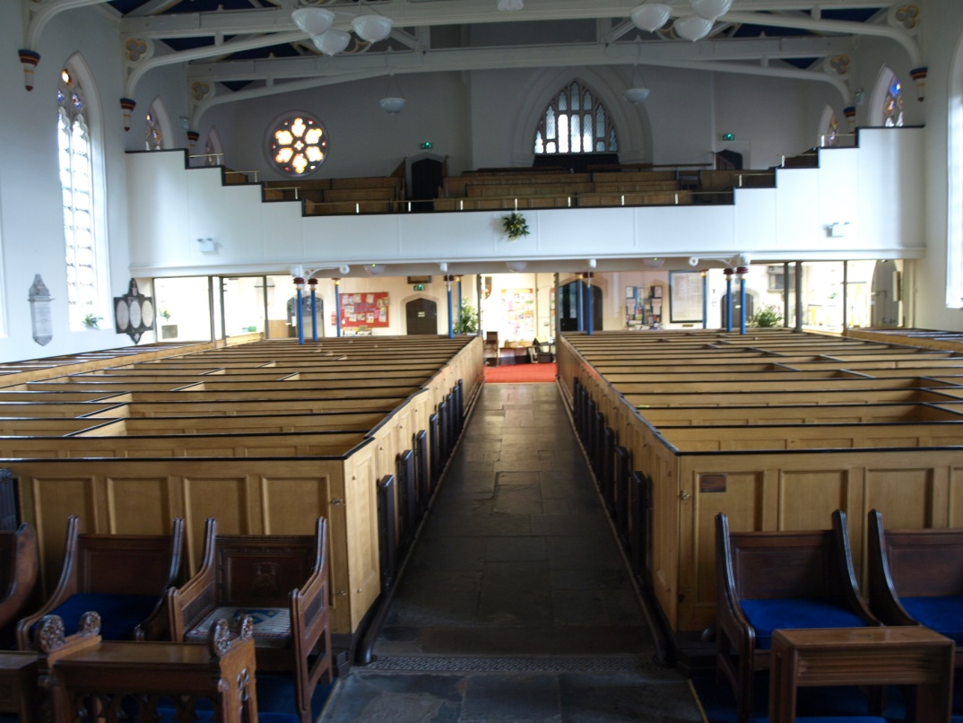
The chancel steps.
These steps mark the point where the simpler style of the
evangelical end of the church, which was designed to preach to
the masses, joins the more ornate and sensual Anglo- catholic end
of the church.
Reflection – think about the paradoxes in your life, those areas where life, your personality and the people you have close relationships with, sometimes conflict through difference. Acknowledge the reality of the difference and look for the blessings that this may bring.

Slide 8
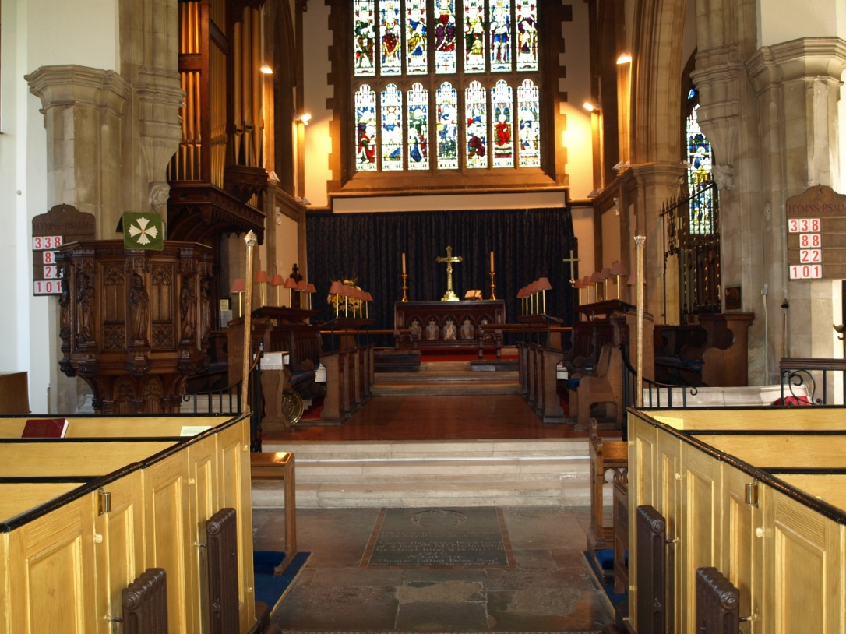
The Foley grave.
Here stand couples to be married and the coffin in funerals.
It is a place where life changes from one state to another.
Reflection – think of the changes you have experienced in life and think about their joys and their sorrows

Slide 9
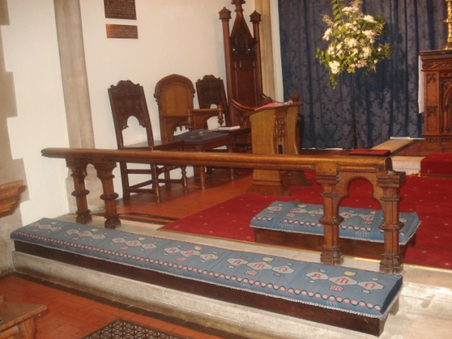
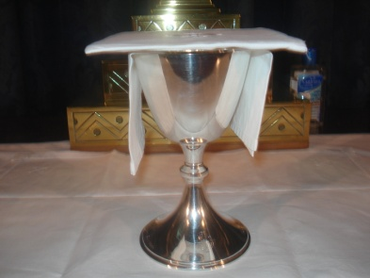
The altar rail and altar.
Look at the altar where we consecrate the bread and wine;
where bread is broken and wine out poured.
From this place each are fed in equal measure.
Reflection - give thanks for all that you have, acknowledge those areas where you have needs and consider those where you have enough to give away.

Slide 10
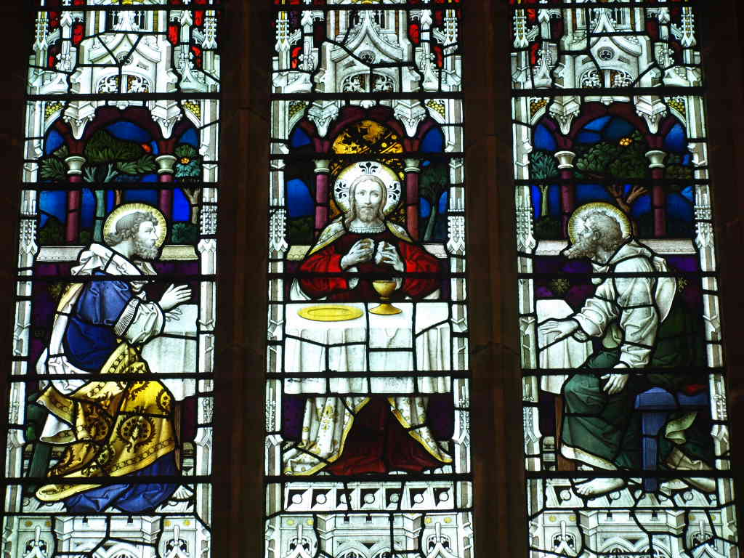
Stained glass window of the Road to Emmaus.
This window celebrates the time that Jesus first appeared to two
of the disciples after his resurrection.
They did not recognise him until he broke the bread at the meal
that he had been invited to join them at.
Reflection – consider those, who through friendship, have supported you through life and the times in which you have shared things with others.

Slide 11
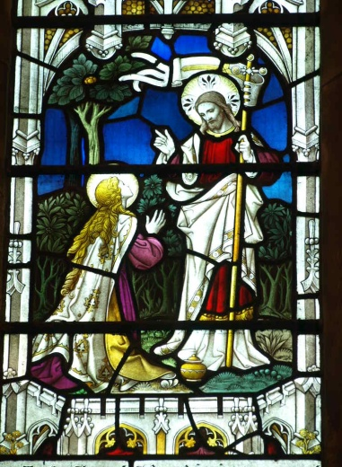
Jesus sends out Mary Magdalene.
Same window, bottom left hand section.
Jesus sent out Mary Magdalene to tell others about him.
Reflection -consider the areas in your life where you feel that you have something to give. Perhaps you are in a time of transition, through changes in work, retirement, disability, family circumstances or ill health. We each have something to bring to life whoever we are.

Slide 12
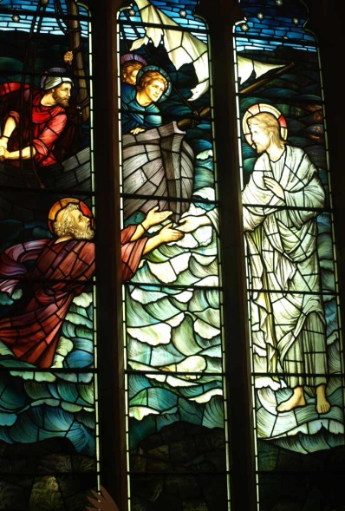
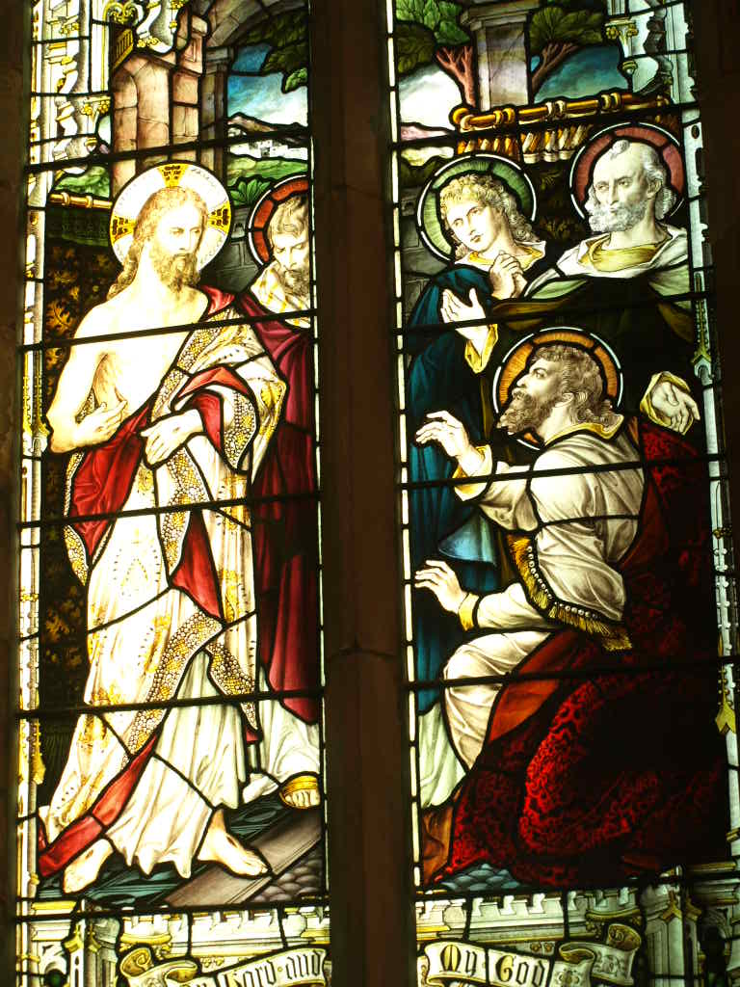
Stained glass windows of Doubting Thomas and Peter walking on the water.
Jesus accepted Thomas’s doubts, when he was not willing to accept that he had risen from the dead and allowed him to find his own certainty.
Jesus recognised Peter’s enthusiasm and then his sudden fear but held him when he lost his certainty and encouraged him through faith.
Reflection – Acknowledge honestly in your heart the swing between doubt and certainty and understand that we are accepted wherever we are in the pendulum.

Slide 13
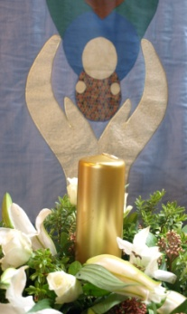
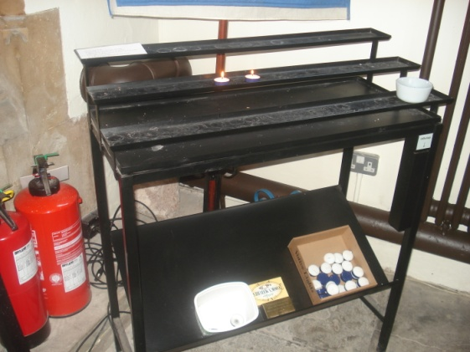

Candle stand and prayer board – Candles are a wonderful way of saying a prayer without needing words.
Reflection – take time to offer your thoughts of the journey through the church. You might like to light a candle or say a prayer.

Slide 14

As you leave this pilgrimage we wish you God’s blessing.
‘Go in peace to love and serve the Lord’.

