Slide 1
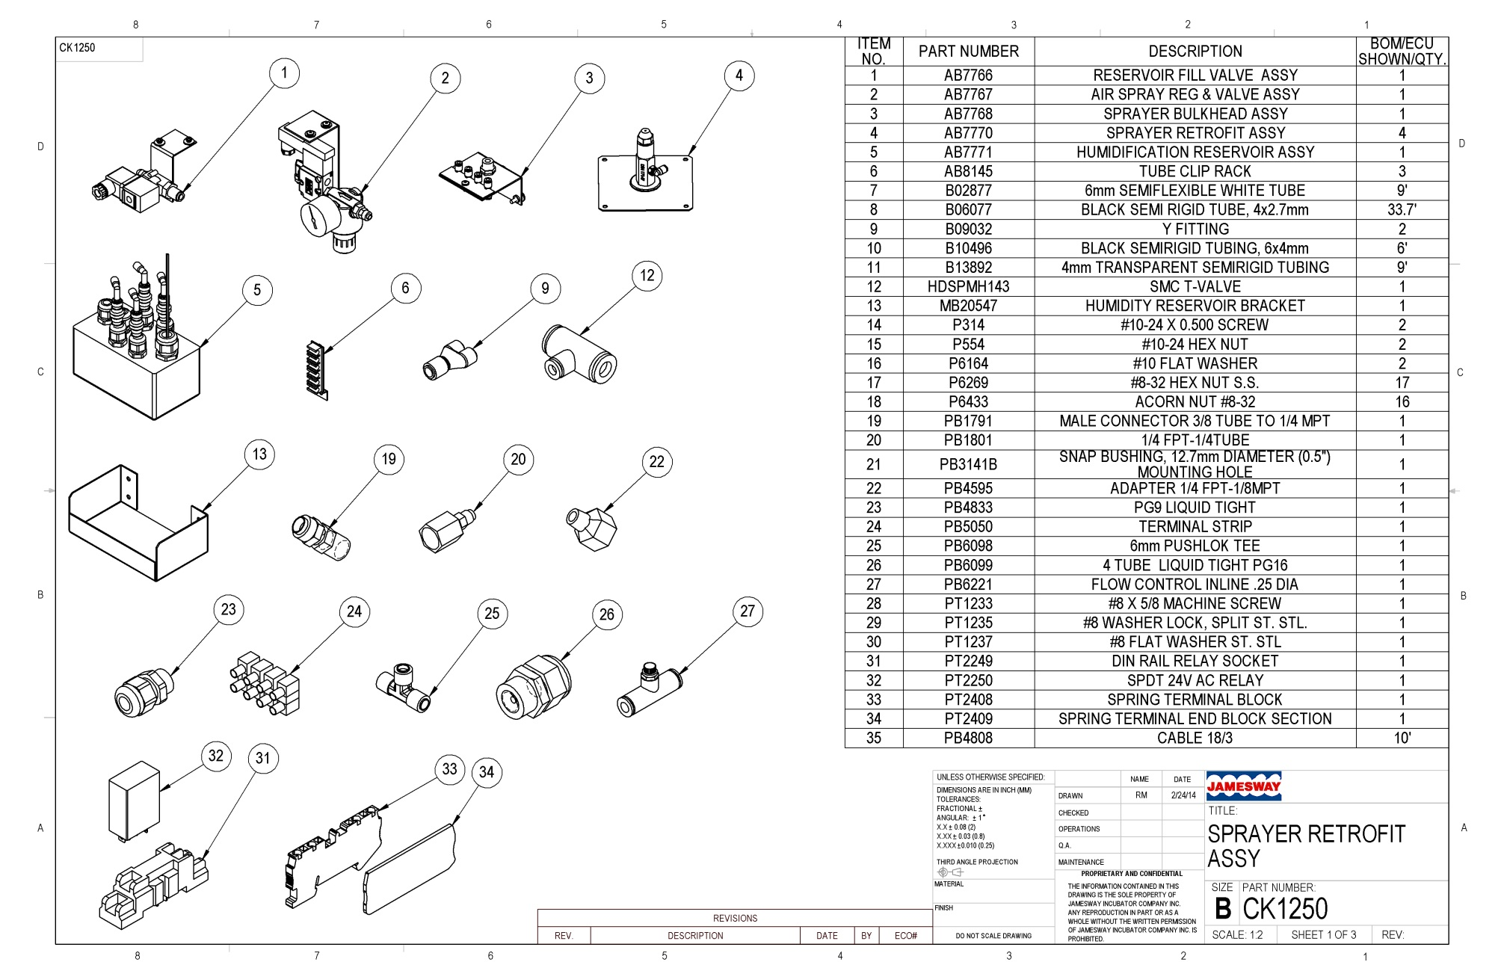
SINGLE DEPTH P2 HUMIDIFICATION PARTS LIST

Slide 2
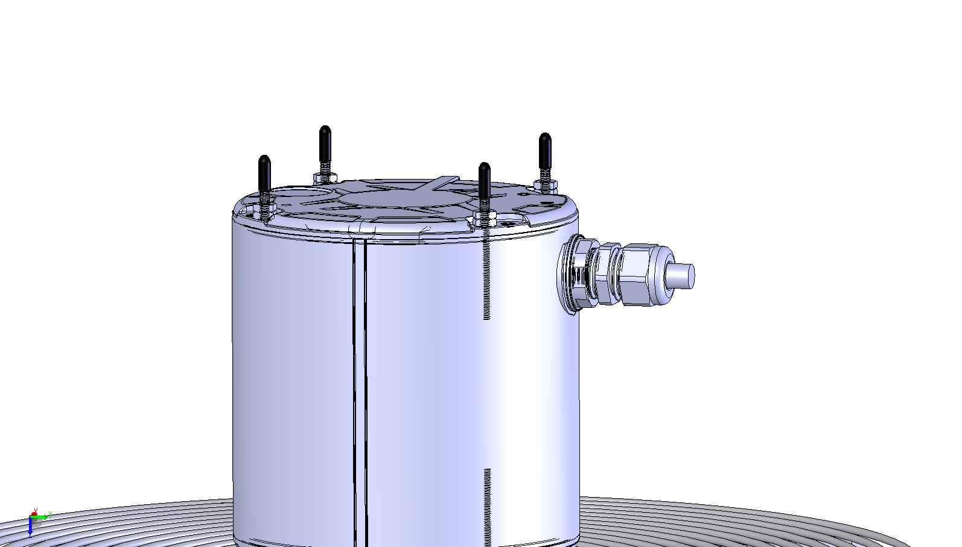
REMOVE CAPS FROM MOTORS

Slide 3
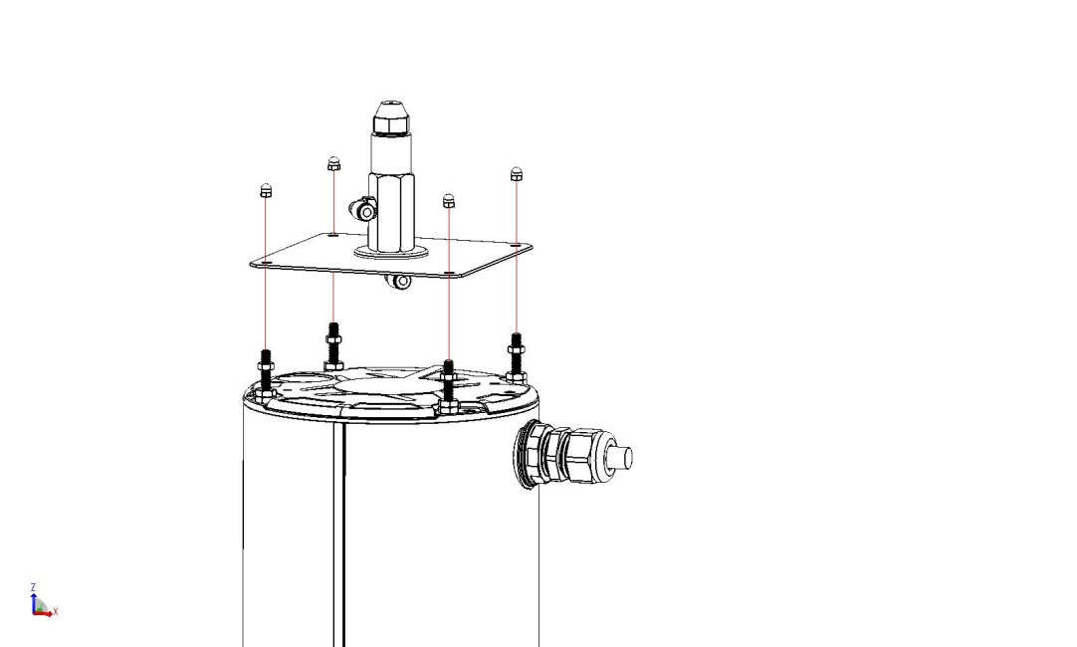
ATTACH AB7770 SPRAYERS TO MOTORS. NOTE SPRAYER TO MOTOR ORIENTATION FOR PROPER TUBE ROUTING
P6433
P6269
MOTOR 1
MOTOR 2
SCREW ON (4)P6269 APPROXIMATELY 5mm ON TO STUD
PLACE AB7770 ON TOP OF NUTS
WRENCH TIGHTEN (4)P6433 NUTS TO TOP OF STUDS
WRENCH TIGHTEN P6269 UP TO BOTTOM OF PLATE

Slide 4
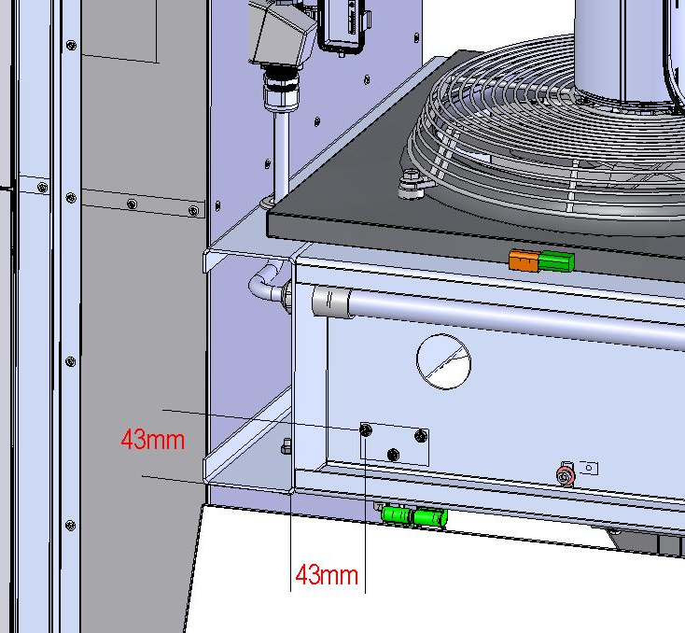
DRILL 3/16”-4.5mm THROUGH
ECU SIDE FRAME. (3 PLACES)
USE AB7768 BRACKET AS
HOLE MARKING TEMPLATE
MOUNTING HOLES FOR AB7768

Slide 5
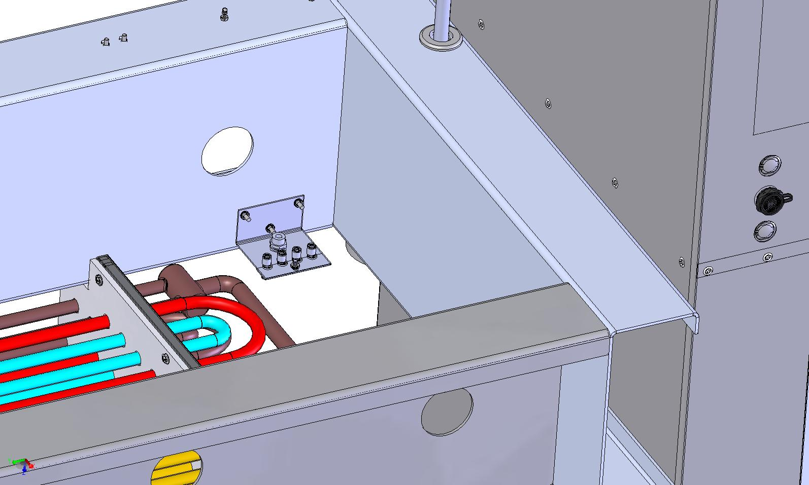
ATTACH AB7768 TO INSIDE OF ECU FRAME AS SHOWN

Slide 6
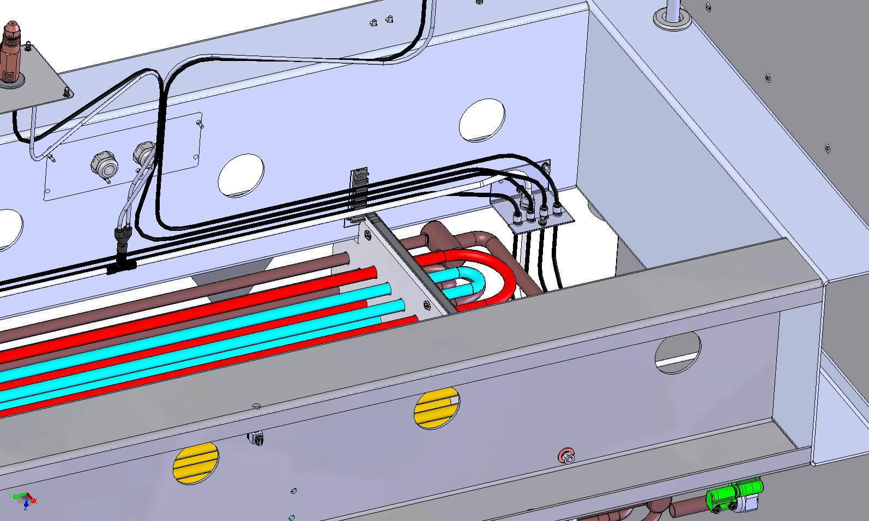
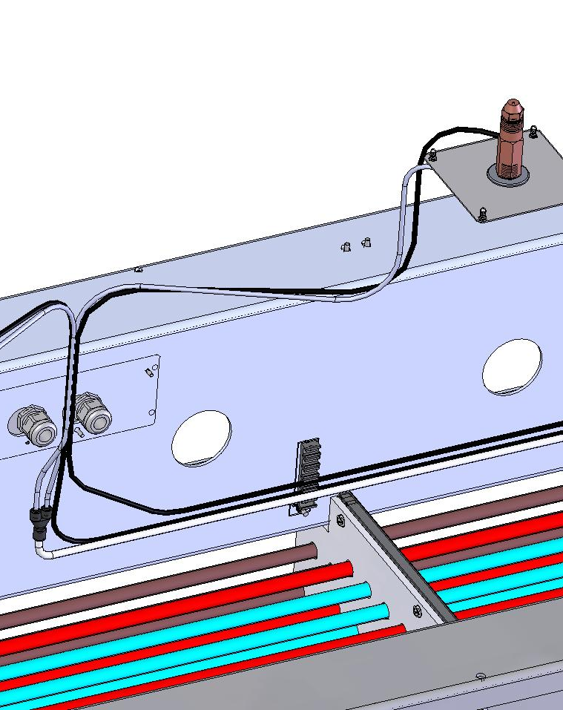
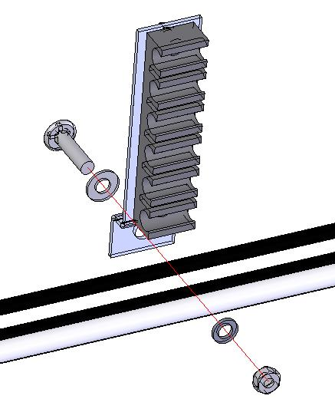
TUBE ROUTING IN ECU FRAME (FAN ASS’Y REMOVED FOR CLARITY)
4mm WHITE
B09032
PB6098
ADD (3) AB8145
TO SUIT
AB8145
PT1233
4mm BLACK
PT1237
PT1235
6mm WHITE
PT6269

Slide 7
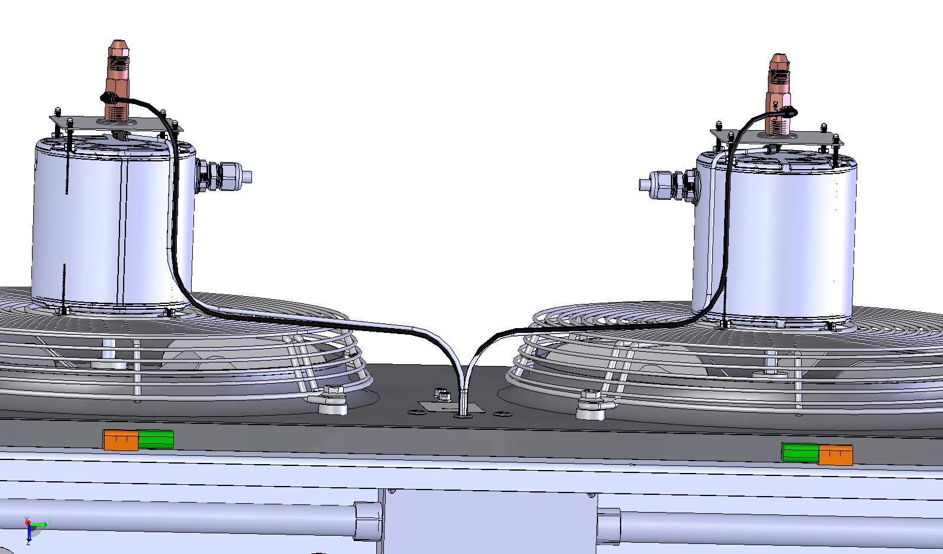
TUBE ROUTING THROUGH FAN ASSY
SECURE TUBES TO MOTOR MOUNT
WITH CABLE TIE WRAPS

Slide 8
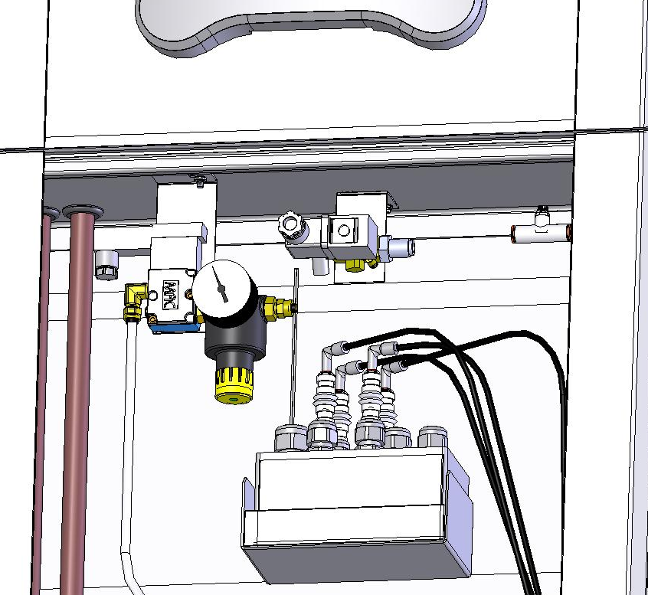
MOUNT VALVE ASSEMBLIES IN CONSOLE
EXISTING MOUNTING HOLES IN CONSOLE PLATE
AB7766
AB7767

Slide 9
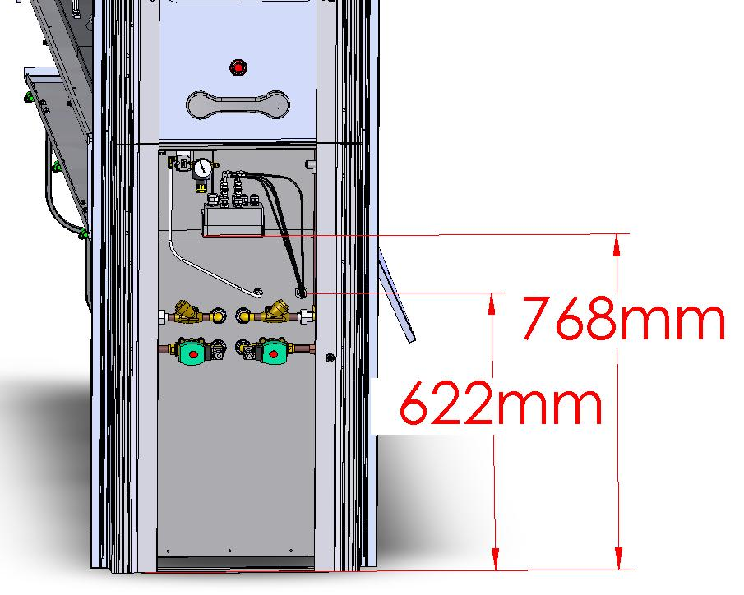
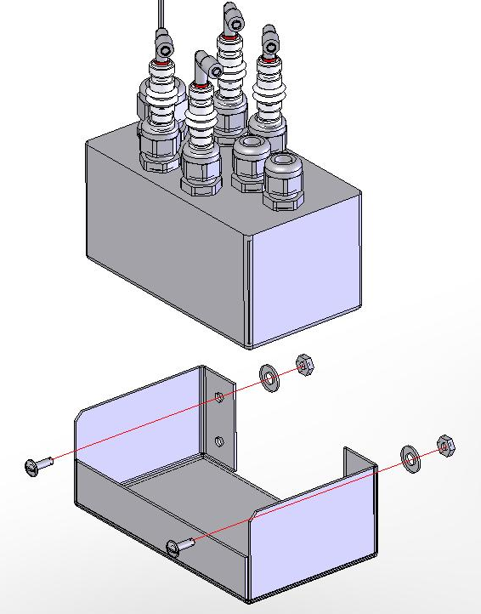
DRILL HOLES THROUGH CONSOLE BACK
USE MB20547 AS HOLE TEMPLATE
DRILL 13/64”-(5mm) THROUGH (2 PLACES)
P314
DRILL 7/8”-(23mm) THROUGH
DRILL 5/8”-(16mm) THROUGH
MB20547

Slide 10
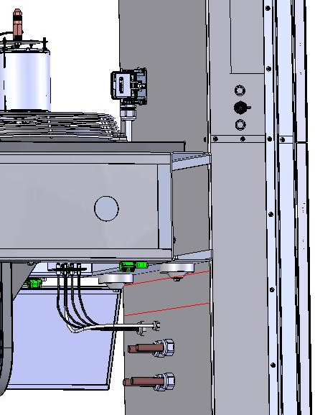
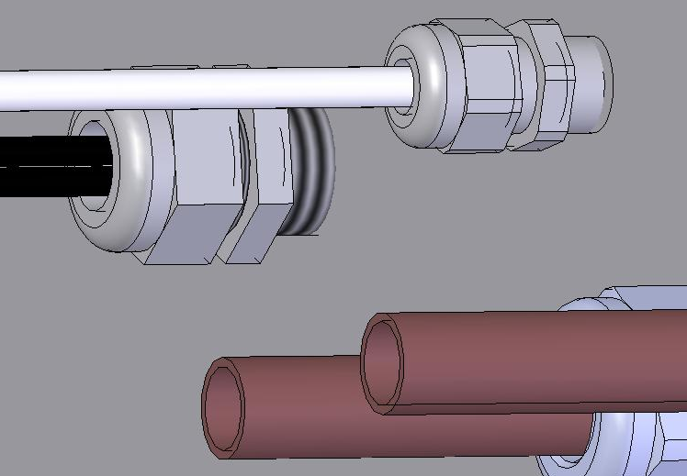
TUBE ROUTING THROUGH BACK OF CONSOLE
(HEATING COILS AND SUPPORT LEG REMOVED FOR CLARITY)
ECU SUPPORT LEG CROSS BRACE IN THIS AREA
ABOVE TUBE FITTINGS
PB4833
PB6099

Slide 11
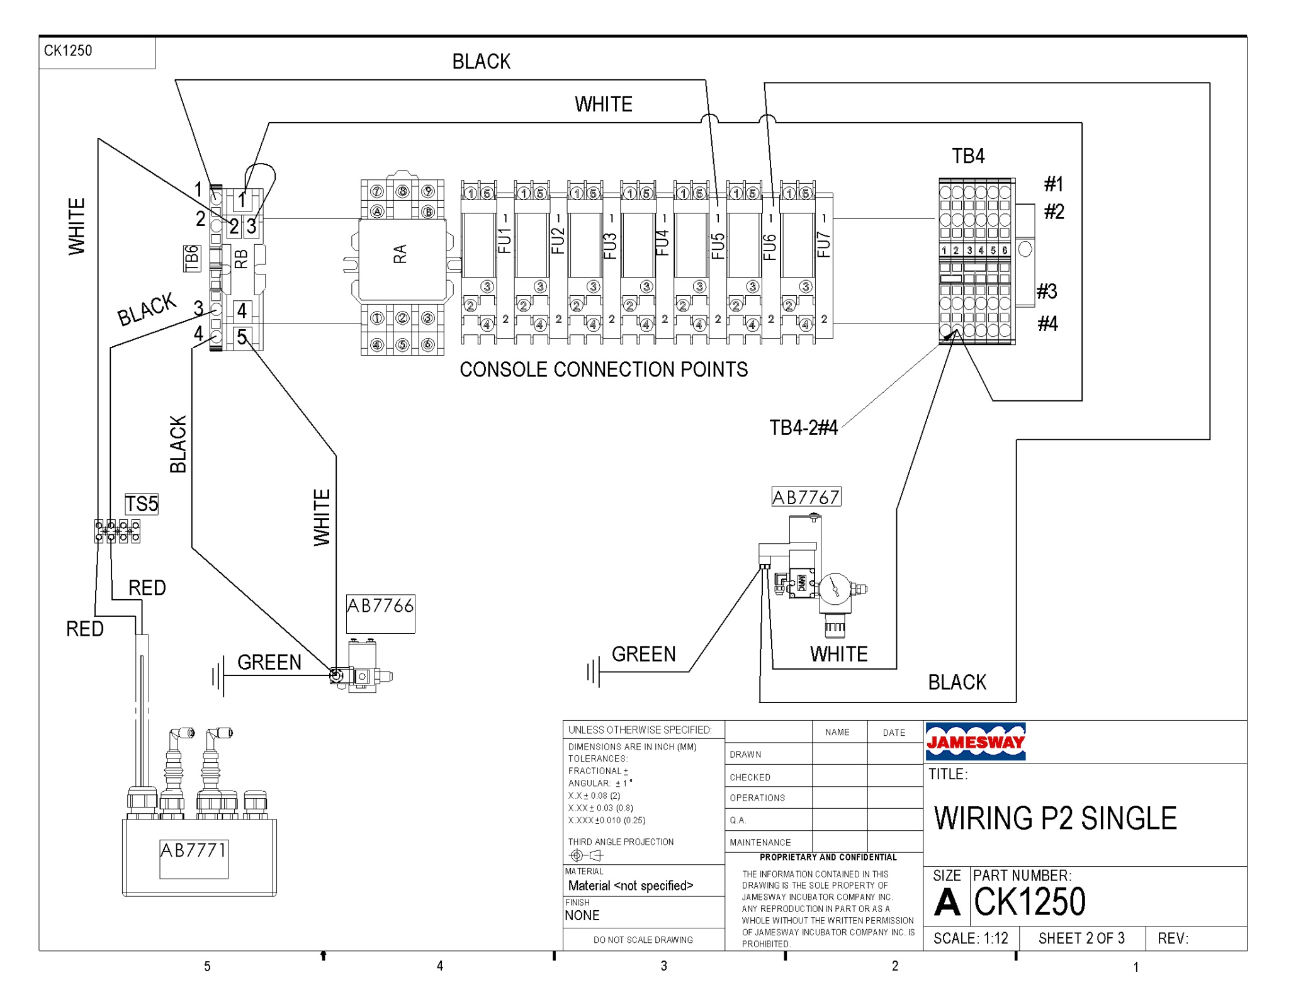

Slide 12


