Slide 1
CHC EasyNav Installation

Slide 2
What is Easy Nav
Entry level system with several great features to accomplish daily task required on various construction site
Not upgradable to full 3D system
Does not have the ability to import design files
Requires less components than more advance models
All outside components are installed on boom and stick
  Allow the system to be install on swing booms without additional hardware

Slide 3
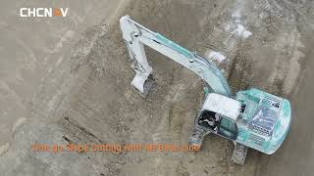

Slide 4
Minimum Tooling Requirements
Simple socket set
Cutters
Wire Crimper
Wire Strippers
Welding tools
Part clean
Zip ties
Machine keys
OEM paint
PPE
Plumb Bob
Tape measure(us. Ft or meters)
4 foot level
Torpedo level (magnetic)
Framing square

Slide 5
Safety and Key Check Points
Ensure work area is clear as possibly from any hazards
Machine is in safe working condition
Beware of pinch points
Proper PPE is worn at all times
Tools are in safe working conditions
Welding is performed ensure all flammable items are at safe distance
Other are aware of arc flash
Grinding direction is considered
Use of weld blanket as needed
MACHINE GROUND TURNED OFF

Slide 6
Installation Resources Available
Benchmark University
CHC Installation Guides
Benchmark Support
Installation videos

Slide 7

Install Timeline
The Easy Nav system should be installed and calibrated within 4 hours. The following chart shows key points in the installation process.
Time Range | Task Completed
0-1 Hours | Precheck, Pre-Plan, Hardware mounting installed
1-2 Hours | Exterior hardware mounted, Exterior cables routed
2-3 Hours | Interior hardware mounted, All cables routed and connected
3-4 Hours | Calibration, Verification, and Paperwork

Slide 8
Kit Overview
All main components come in one kit with two optional kits, the radio and tilt bucket are separate kits.
The kits while contain all the necessary cabling, components, mounting hardware, and accessories to complete the installation.
BOM breakdown

Slide 9
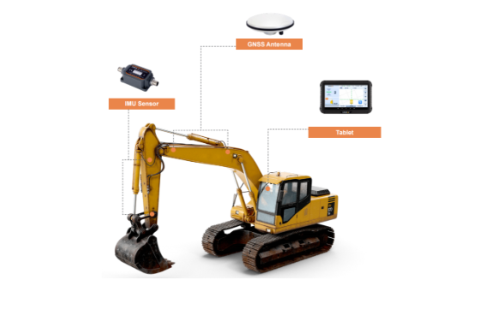
Components
Sensors
Sensors mounts
Terminators
Sensor cables
GPS antenna
Antenna mounts
GPS Cables
Display
Display mounts
Cabling
Radio

Slide 10
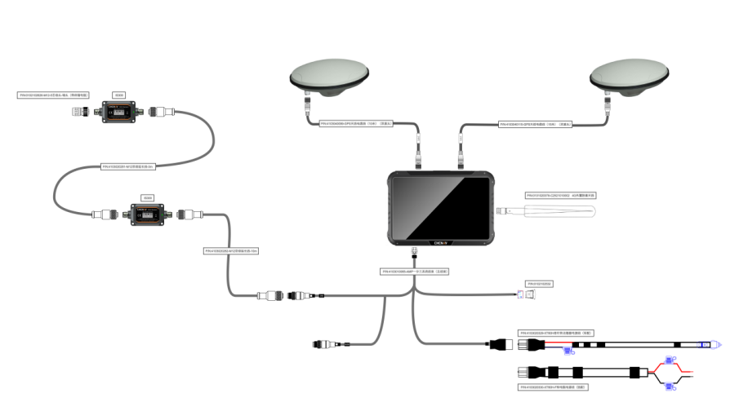

Slide 11
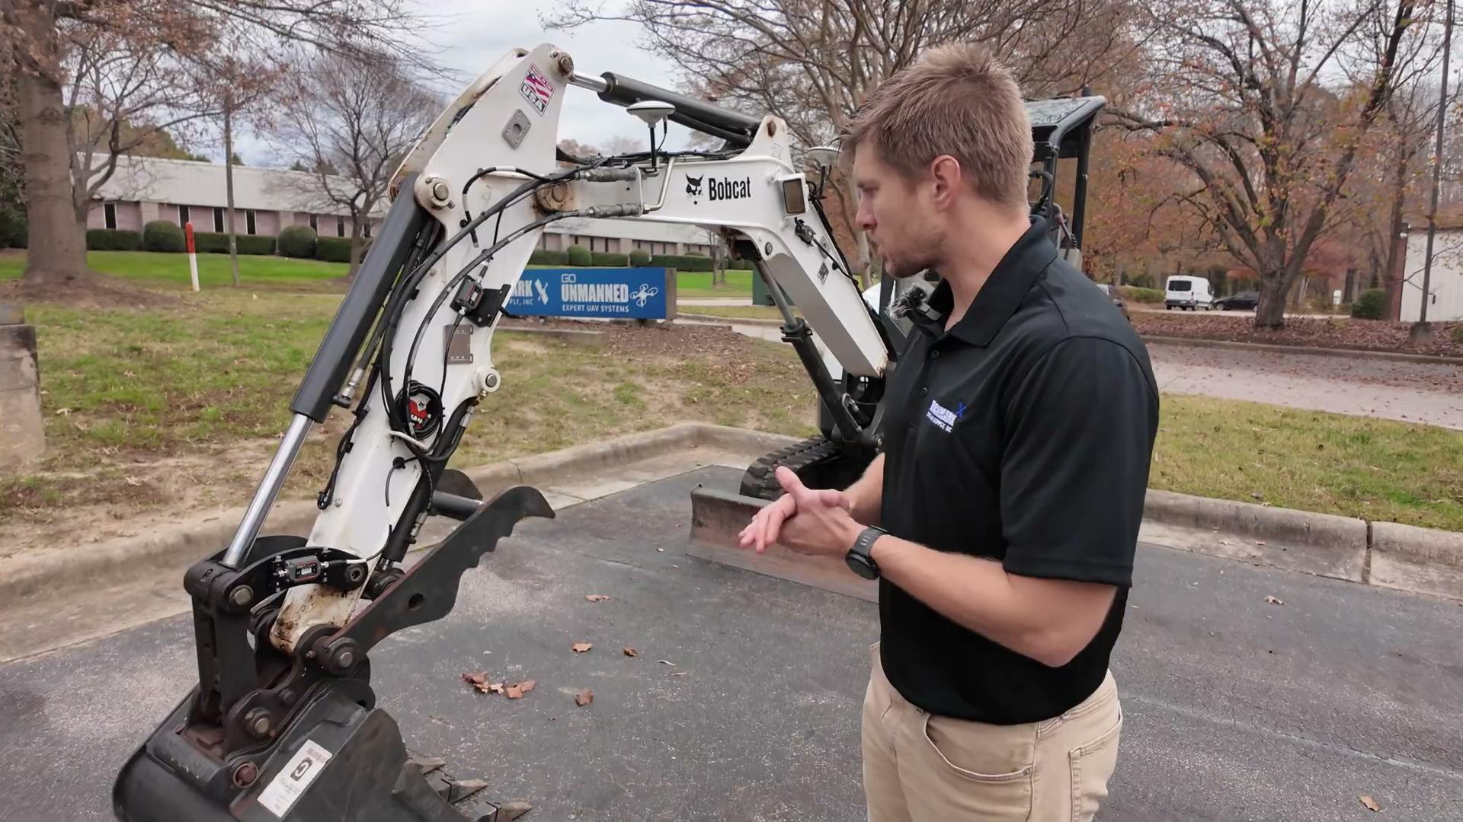

Slide 12
Hardware Installation
80% of install do not change from machine to machine but 20% of each is creativity for mounting and cable routing

Slide 13
Install Process
Machine inspection
  Make, model, and serial number
Preplan
  Mounting type
  Mounting location
  Cable routing
  Display location
  Cab access
Start at bucket work towards cab

Slide 14
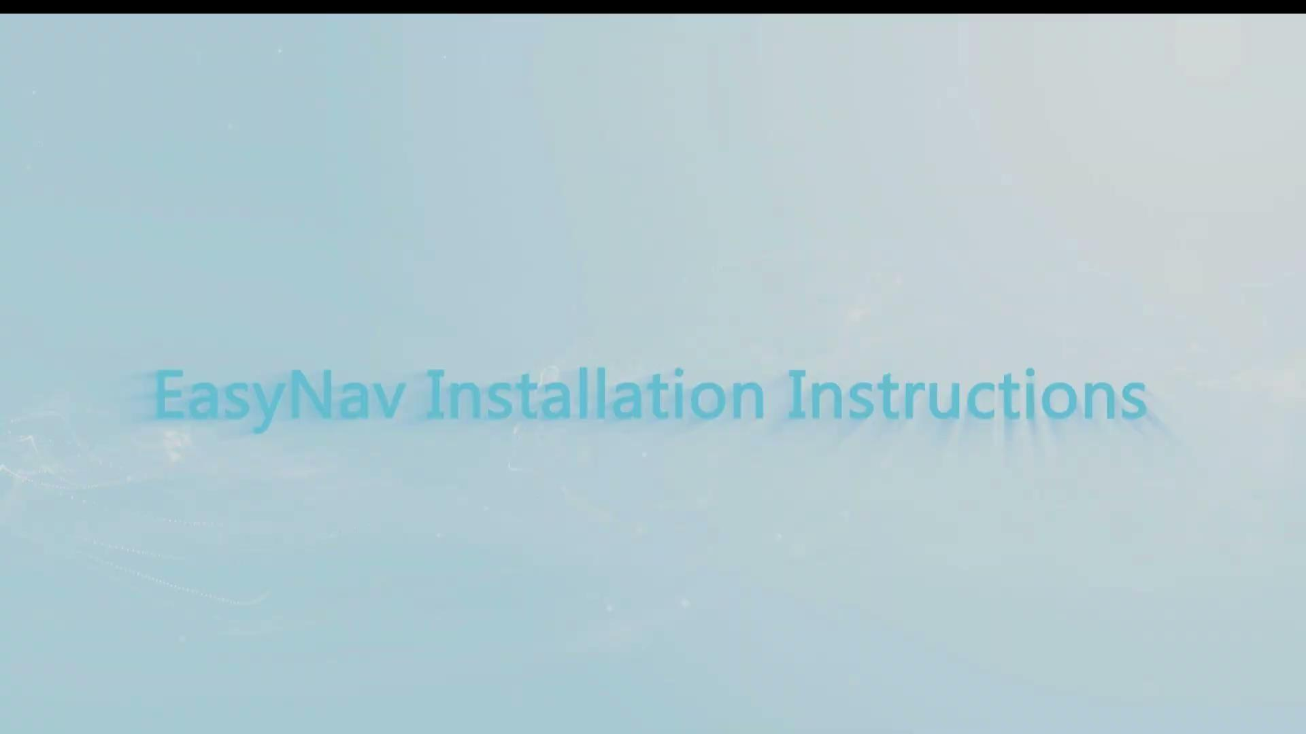
Pre-install Video CHC video

Slide 15
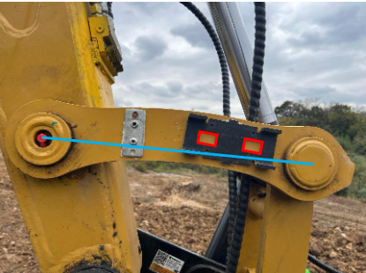
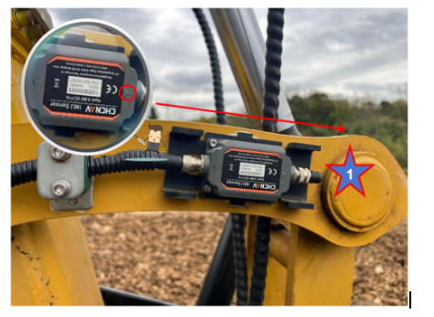
Bucket Sensor Installation
Mounting Locations
  Quick Coupler
  Dogbone
Mounting Types
  Weld on( Weld just center of sensor plate)
Cable Routing
  Plan for machine movement to prevent cable stretch
  Look for snag points
  Generally we follow a hydraulic hose
Alignment
  Ensure the centerline of the sensor is parallel to the Centerline of the dog bone
  Ensure arrow is the correct direction
Terminator

Slide 16
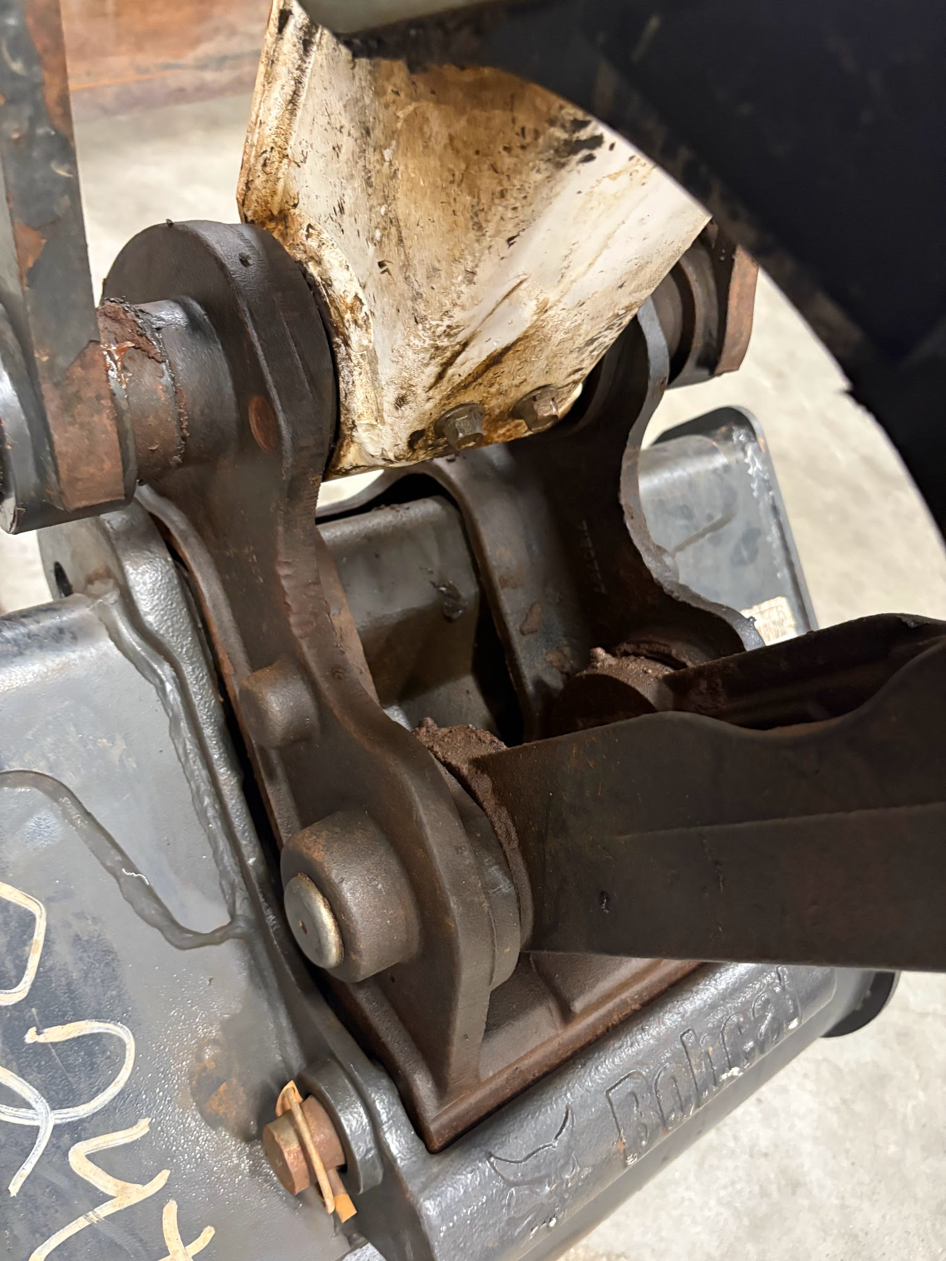
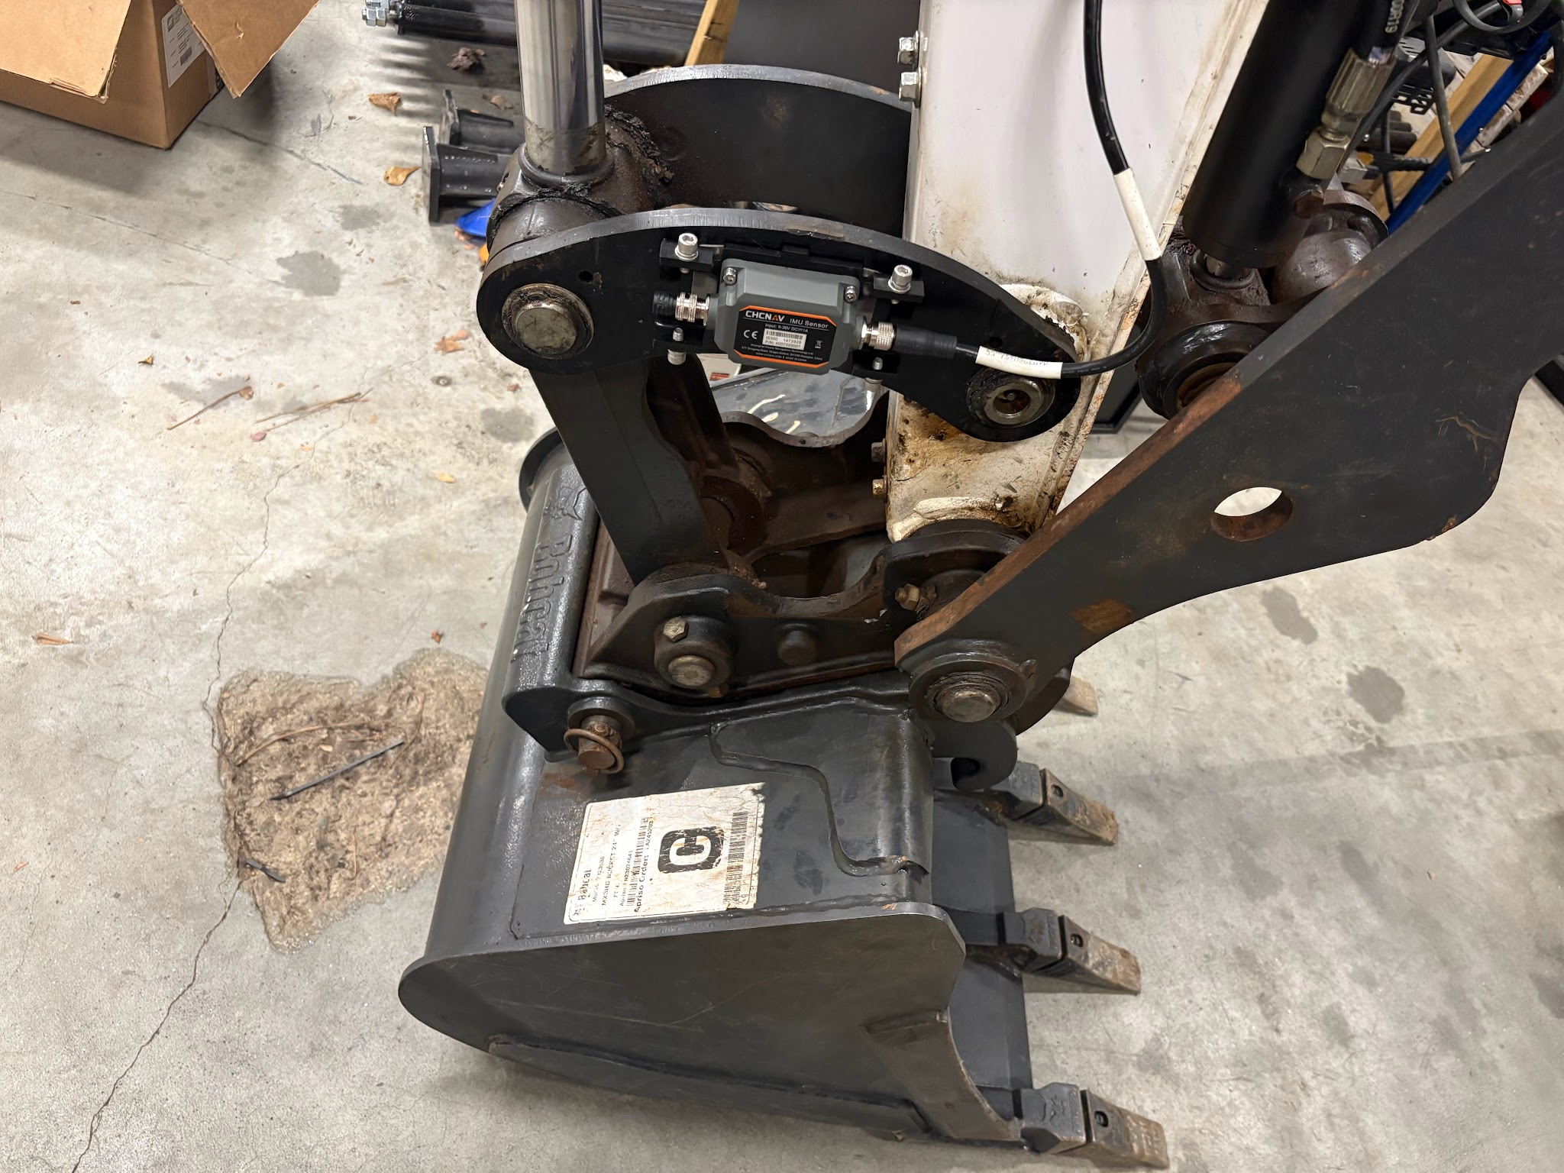
Dogbone vs Quick Coupler
Quick Coupler
Dogbone

Slide 17
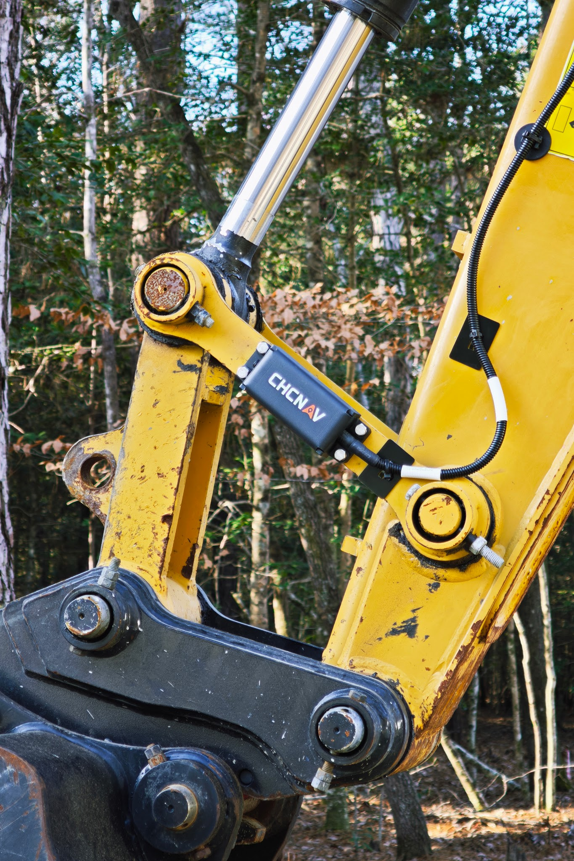

Slide 18
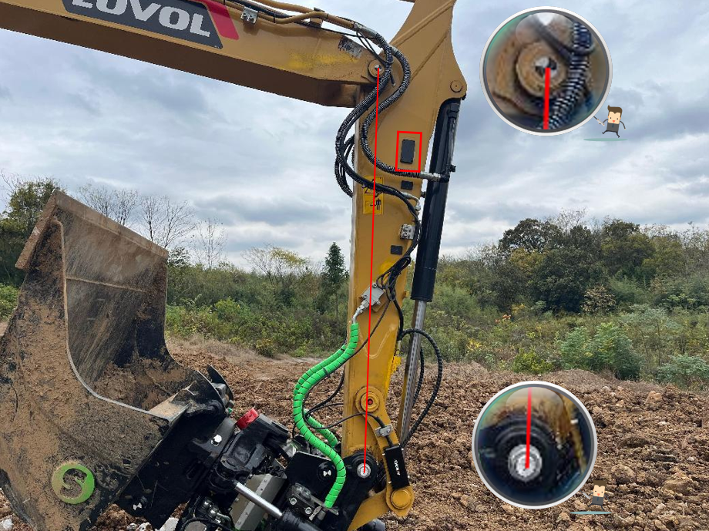
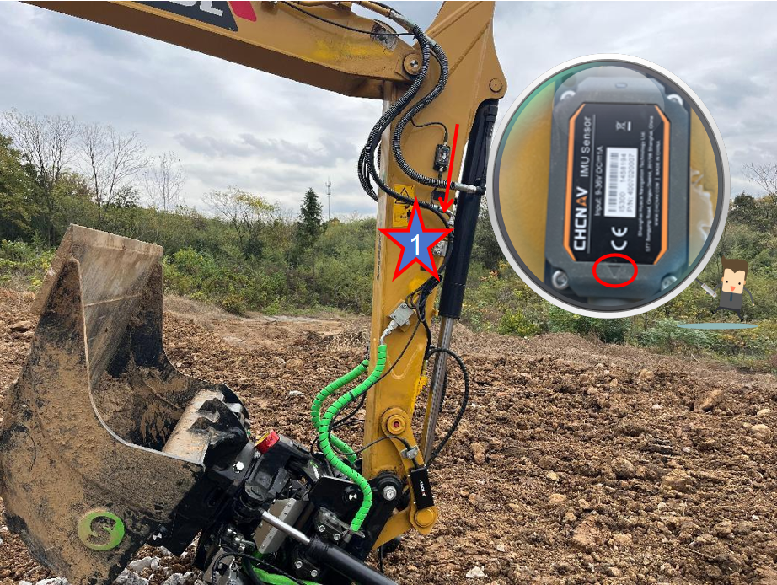
Stick Sensor Installation
Mounting Hardware
  Glue on plate
Location
  Max out the bucket sensor cable with small service loop to determine sensor location
Alignment
  The Centerline of the sensor should be parallel to the centerline of the stick pins
  Ensure arrow is the correct direction
Cable Routing
  Verify cable will not stretch with machine movements
  Follow hydro hose to run towards cab

Slide 19
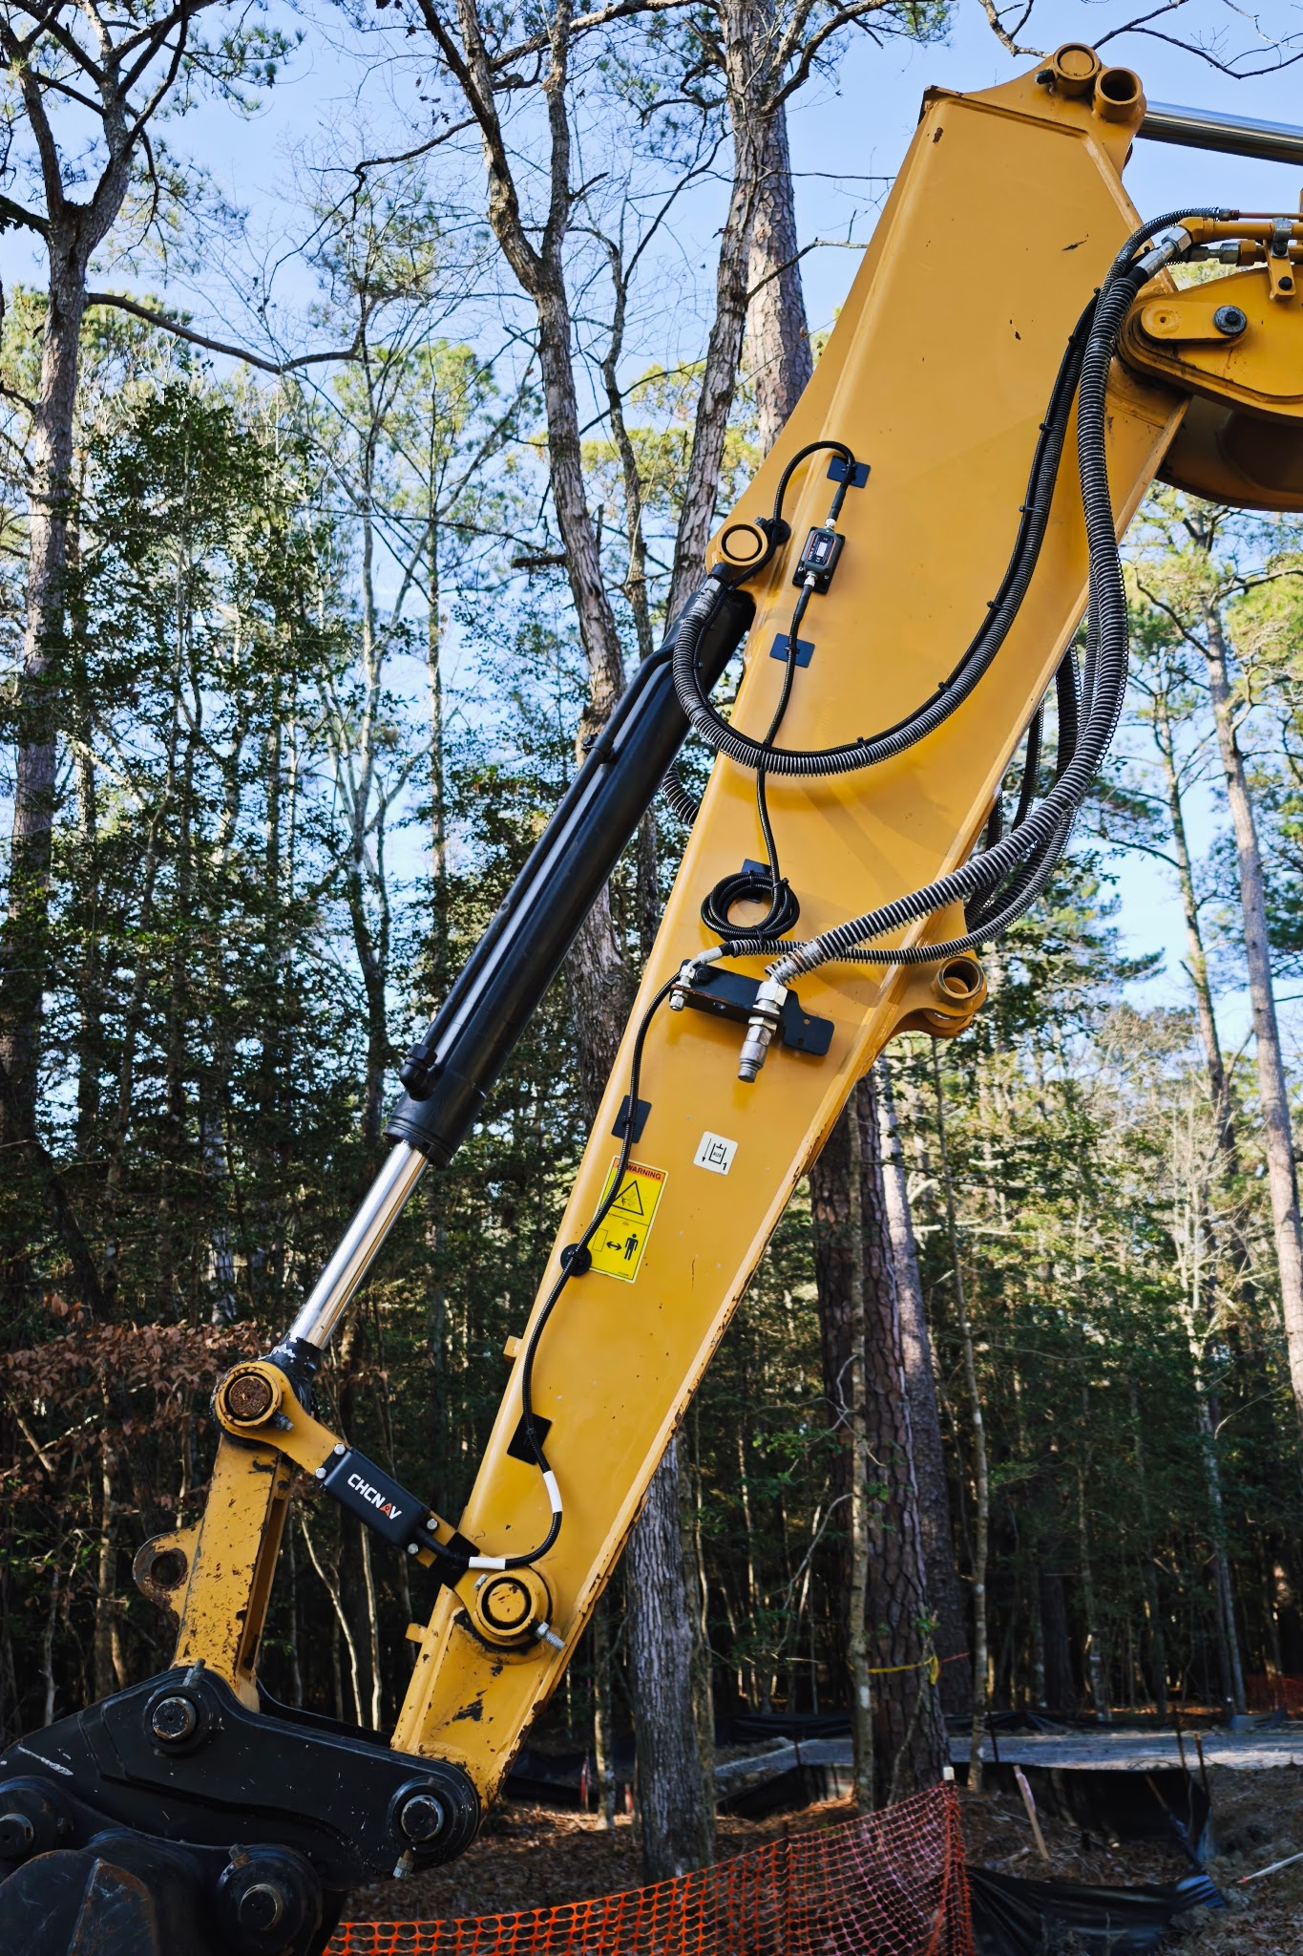

Slide 20
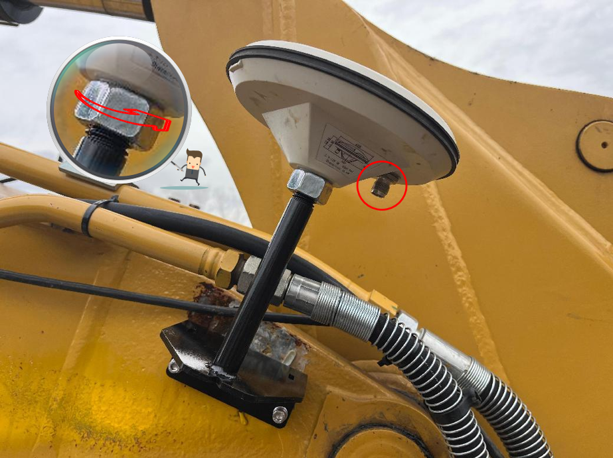
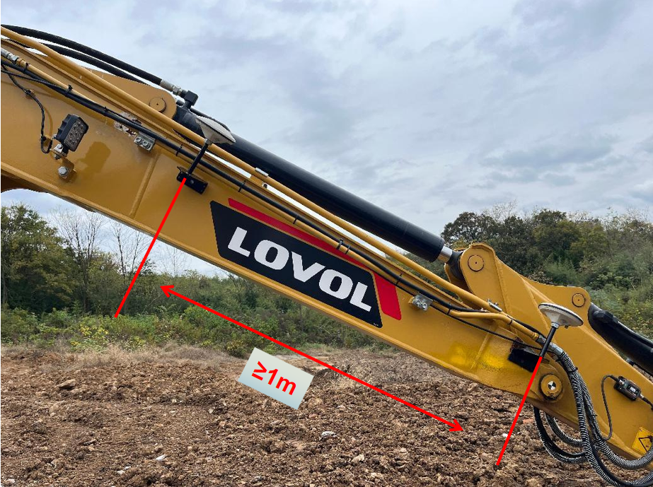
GPS Antennas
Mounting Hardware
  Weld on plate(Weld just the center of the plate)
  Adjust Jam nut to hold antenna
Location
  Front should be as close the pin as possible this will help with calibrations
  Verify no obstruction above antenna and proper clearance is available
  Ensure at least 1 meter of separation between antennas
  Bracket should be close to top of boom
Alignement
  Try to find a balance for the angle of the bracket we want the antenna to be point up towards the sky during most machine geometry
  Ensure the cable connector is on the inside
Cable Routing
  Run the stick sensor cable and the GPS cable with a service loop towards the Aux antenna
  Continue down boom towards cab access point

Slide 21
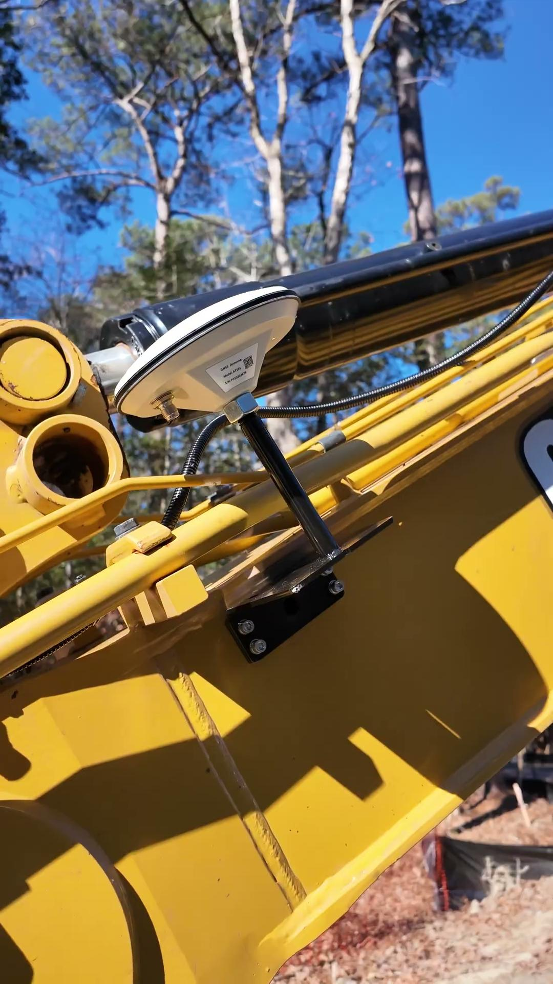

Slide 22
Cab Access
Gaining access to the inside of the cab is one of the hardest parts of the installation. All machines are different but general access can be found in a few different locations. We 6 cables that are needed in the cab (GNSS1, GNSS2, CAN, Power, Radio Com,and Radio antenna)
Look for access seals in the floor or behind the operators seat
Sometimes the interior trim or plastic may have to be remove in order to locate an access
Cab access may also be underneath the floor pan
If no access is available drilling may be required to obtain access to cab
  Verify no other access is available before drilling
  Ensure drilling is not in the ROPS system or in an area that may damage other components

Slide 23
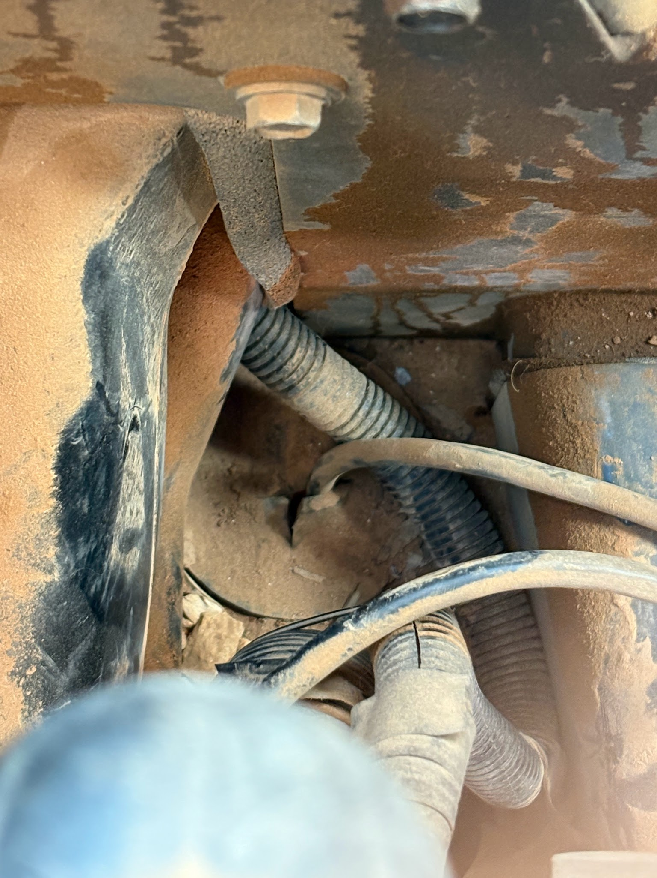
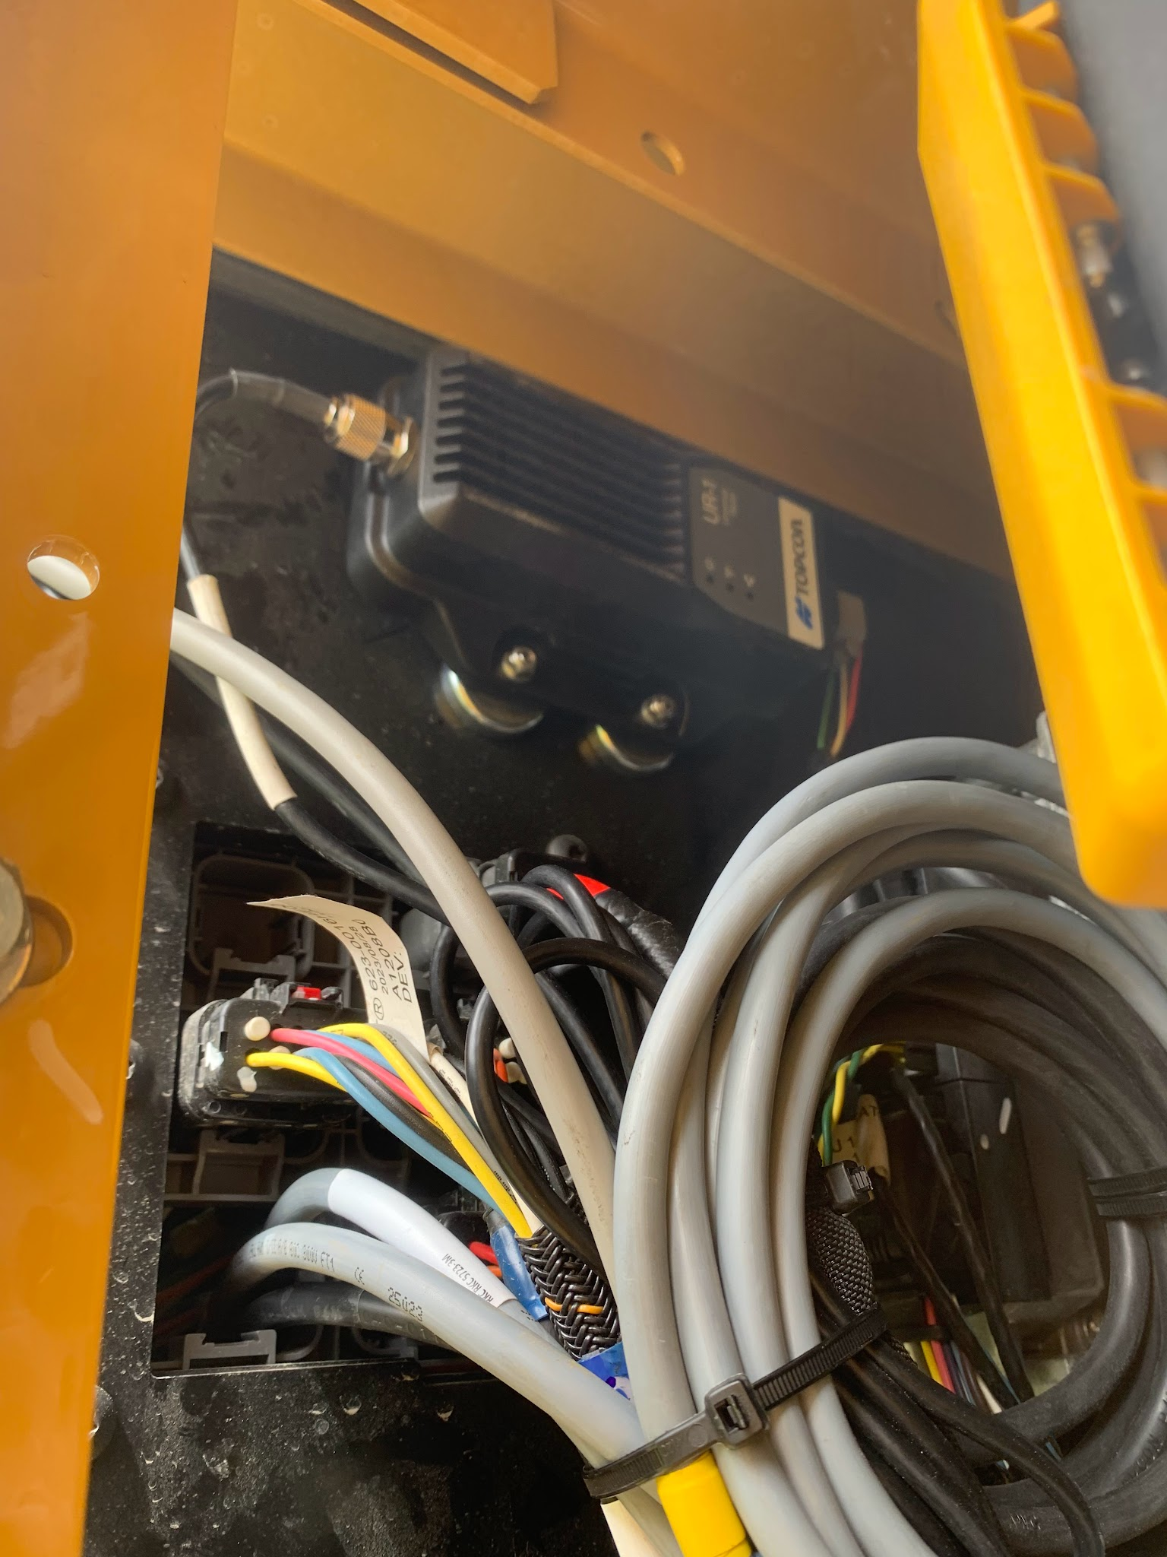
Cab Access Examples

Slide 24
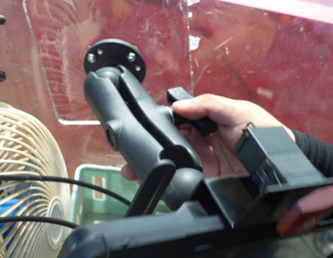
Display Mounting
Mounting Hardware
  Adjustable Ram Hardware
  Glue on plate
    We need to clean the glass before glueing plate
Location
  Generally on the right side glass out of the way of all OEM gauges and switches
  Check for clearance for front window opening
  Ensure a clear path is available for cable routing
Cable Routing
  Try to hide cables behind plastic as best as possible
  Run cables in a way that does not interfere with OEM features of the machine
Ensure the cellular antenna is mounted on the back of the display

Slide 25
Radio
Mounting
  Can be mounted several ways
    Zipties
    Screws
    Magnets
Location
  Best possible concealed location
  Possible places includes
    Behind Operators seat
    Under interior plastic
    Outside under machine covers
The antenna will need to be ran to the top of the cab and has a magnetic base

Slide 26
Cable Connections
Generally all cables should be secured while routing the boom and stick cables towards the access point. Once all the cables are secured up to the access point and all cab cables are secure up to access point. A decision is made for best location to conceal extra cabling.
Depending on access point this can be accomplished a few different ways
Inside the engine compartment
Under the floor pan
Behind plastic inside the cab

Slide 27
Cable Connections
The two GNSS cables will run from the boom through the access seal and up to the back of the display.
  Front antenna goes to GNSS 1 and the rear antenna to GNSS 2
The display connector will run from the display and the Sensor CAN cable, Radio COM Cable, and Power will make there connection.
Power to the system is accomplished by two different methods
  Temp power through cigarette lighter
  Permanent power making a connection to the battery terminals
    This is the preferred most reliable method
      Verify that connection is made on the 24v side if machine is a 24v system

Slide 29
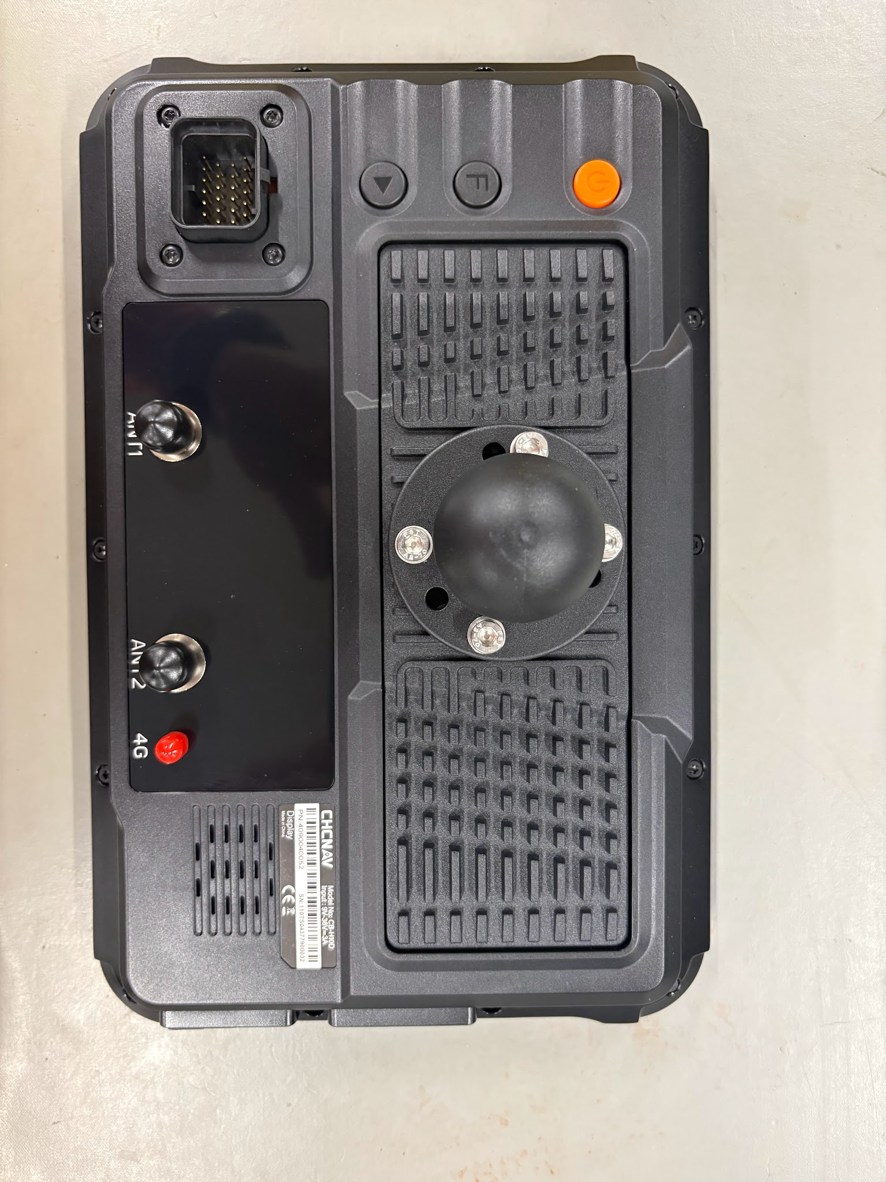

Slide 30
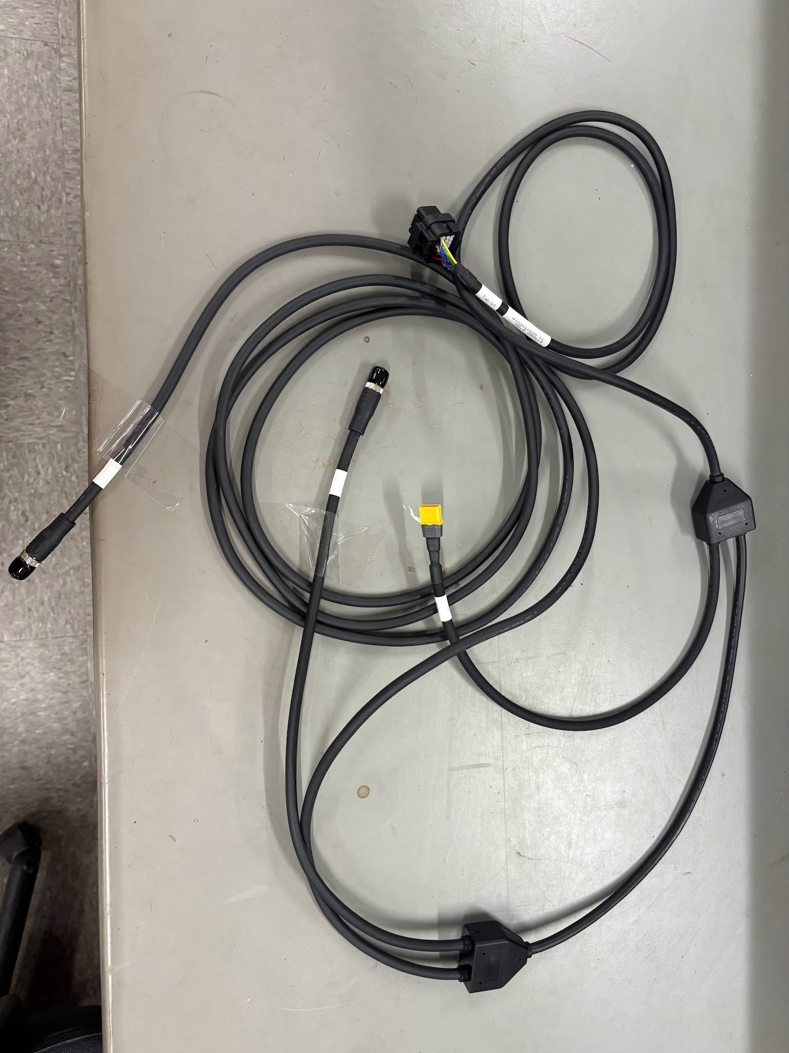
Main Display Cable

Slide 31
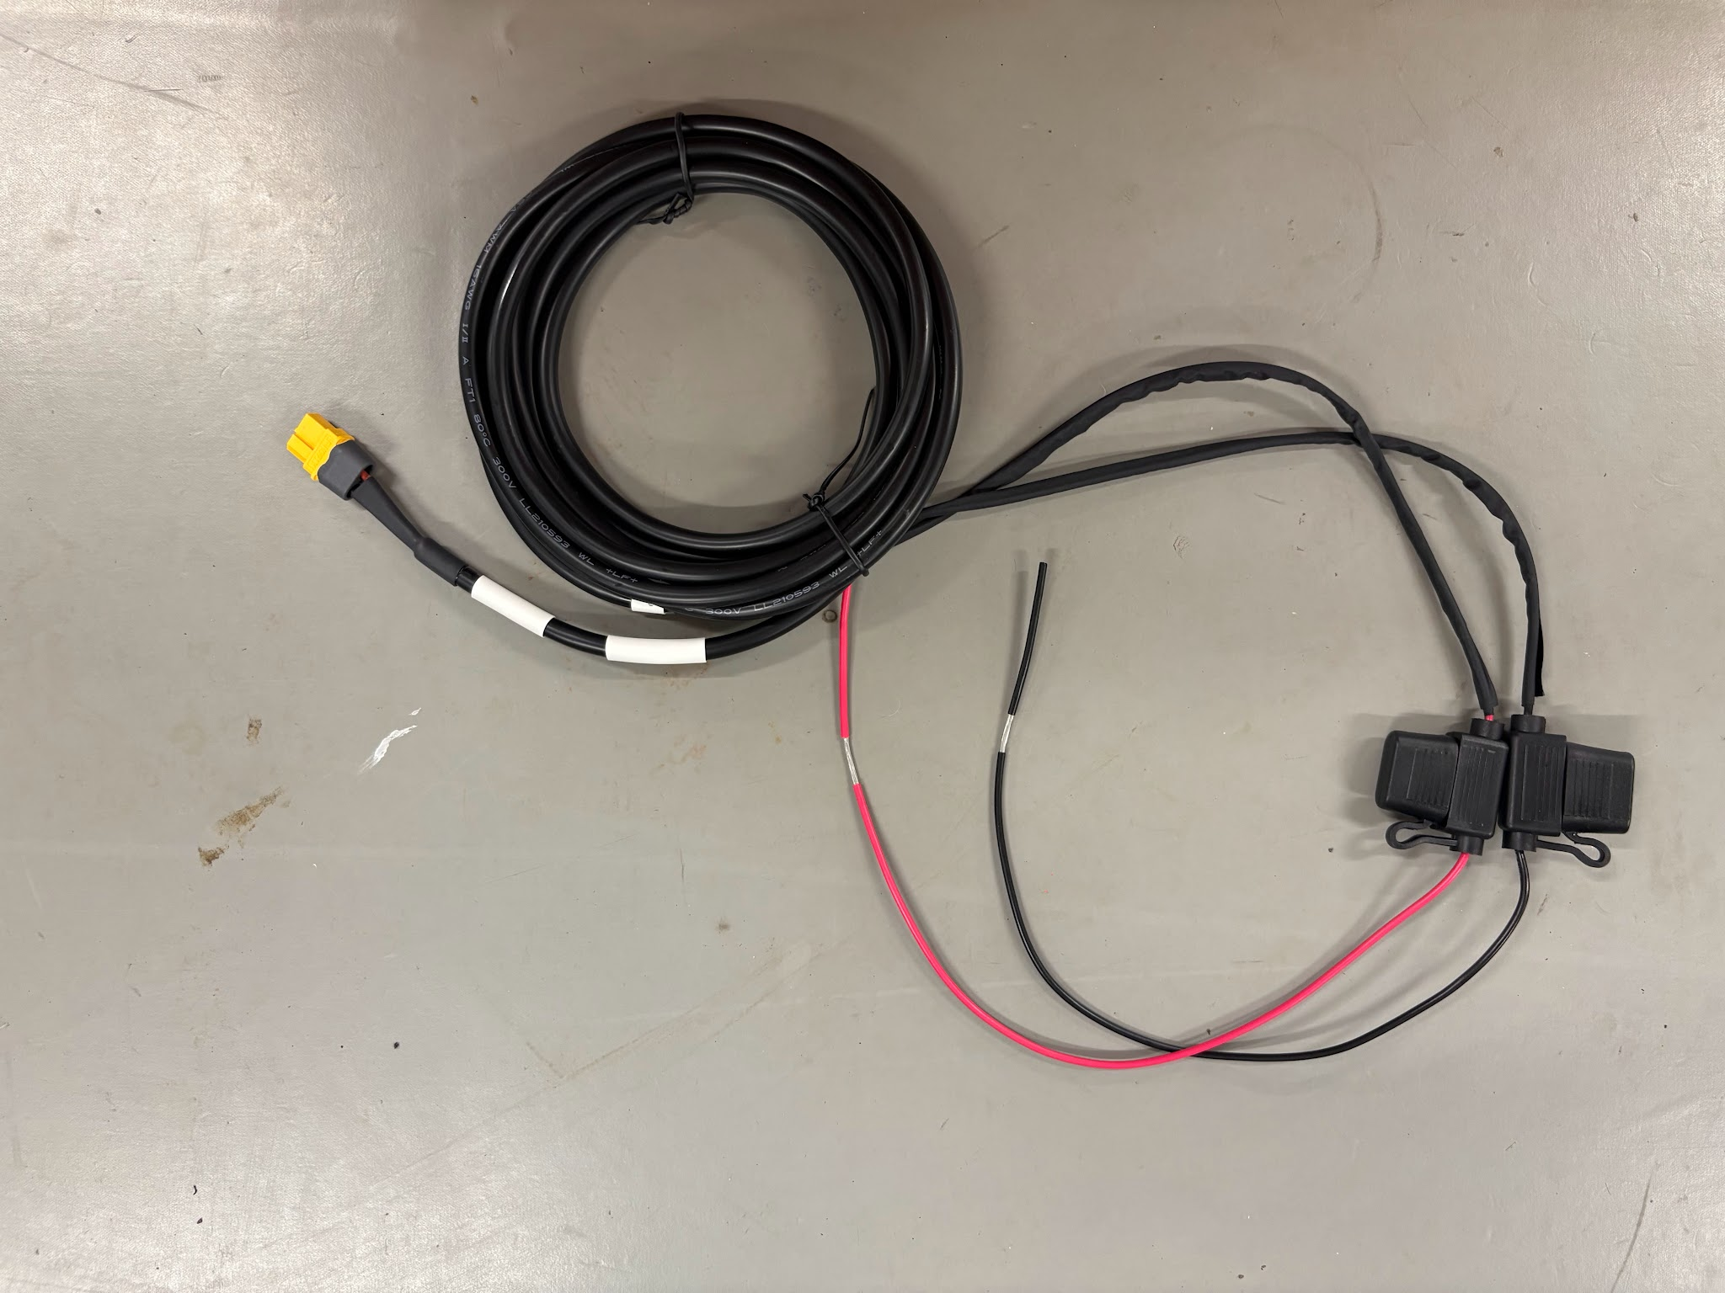
12/24v Battery Cable

Slide 32
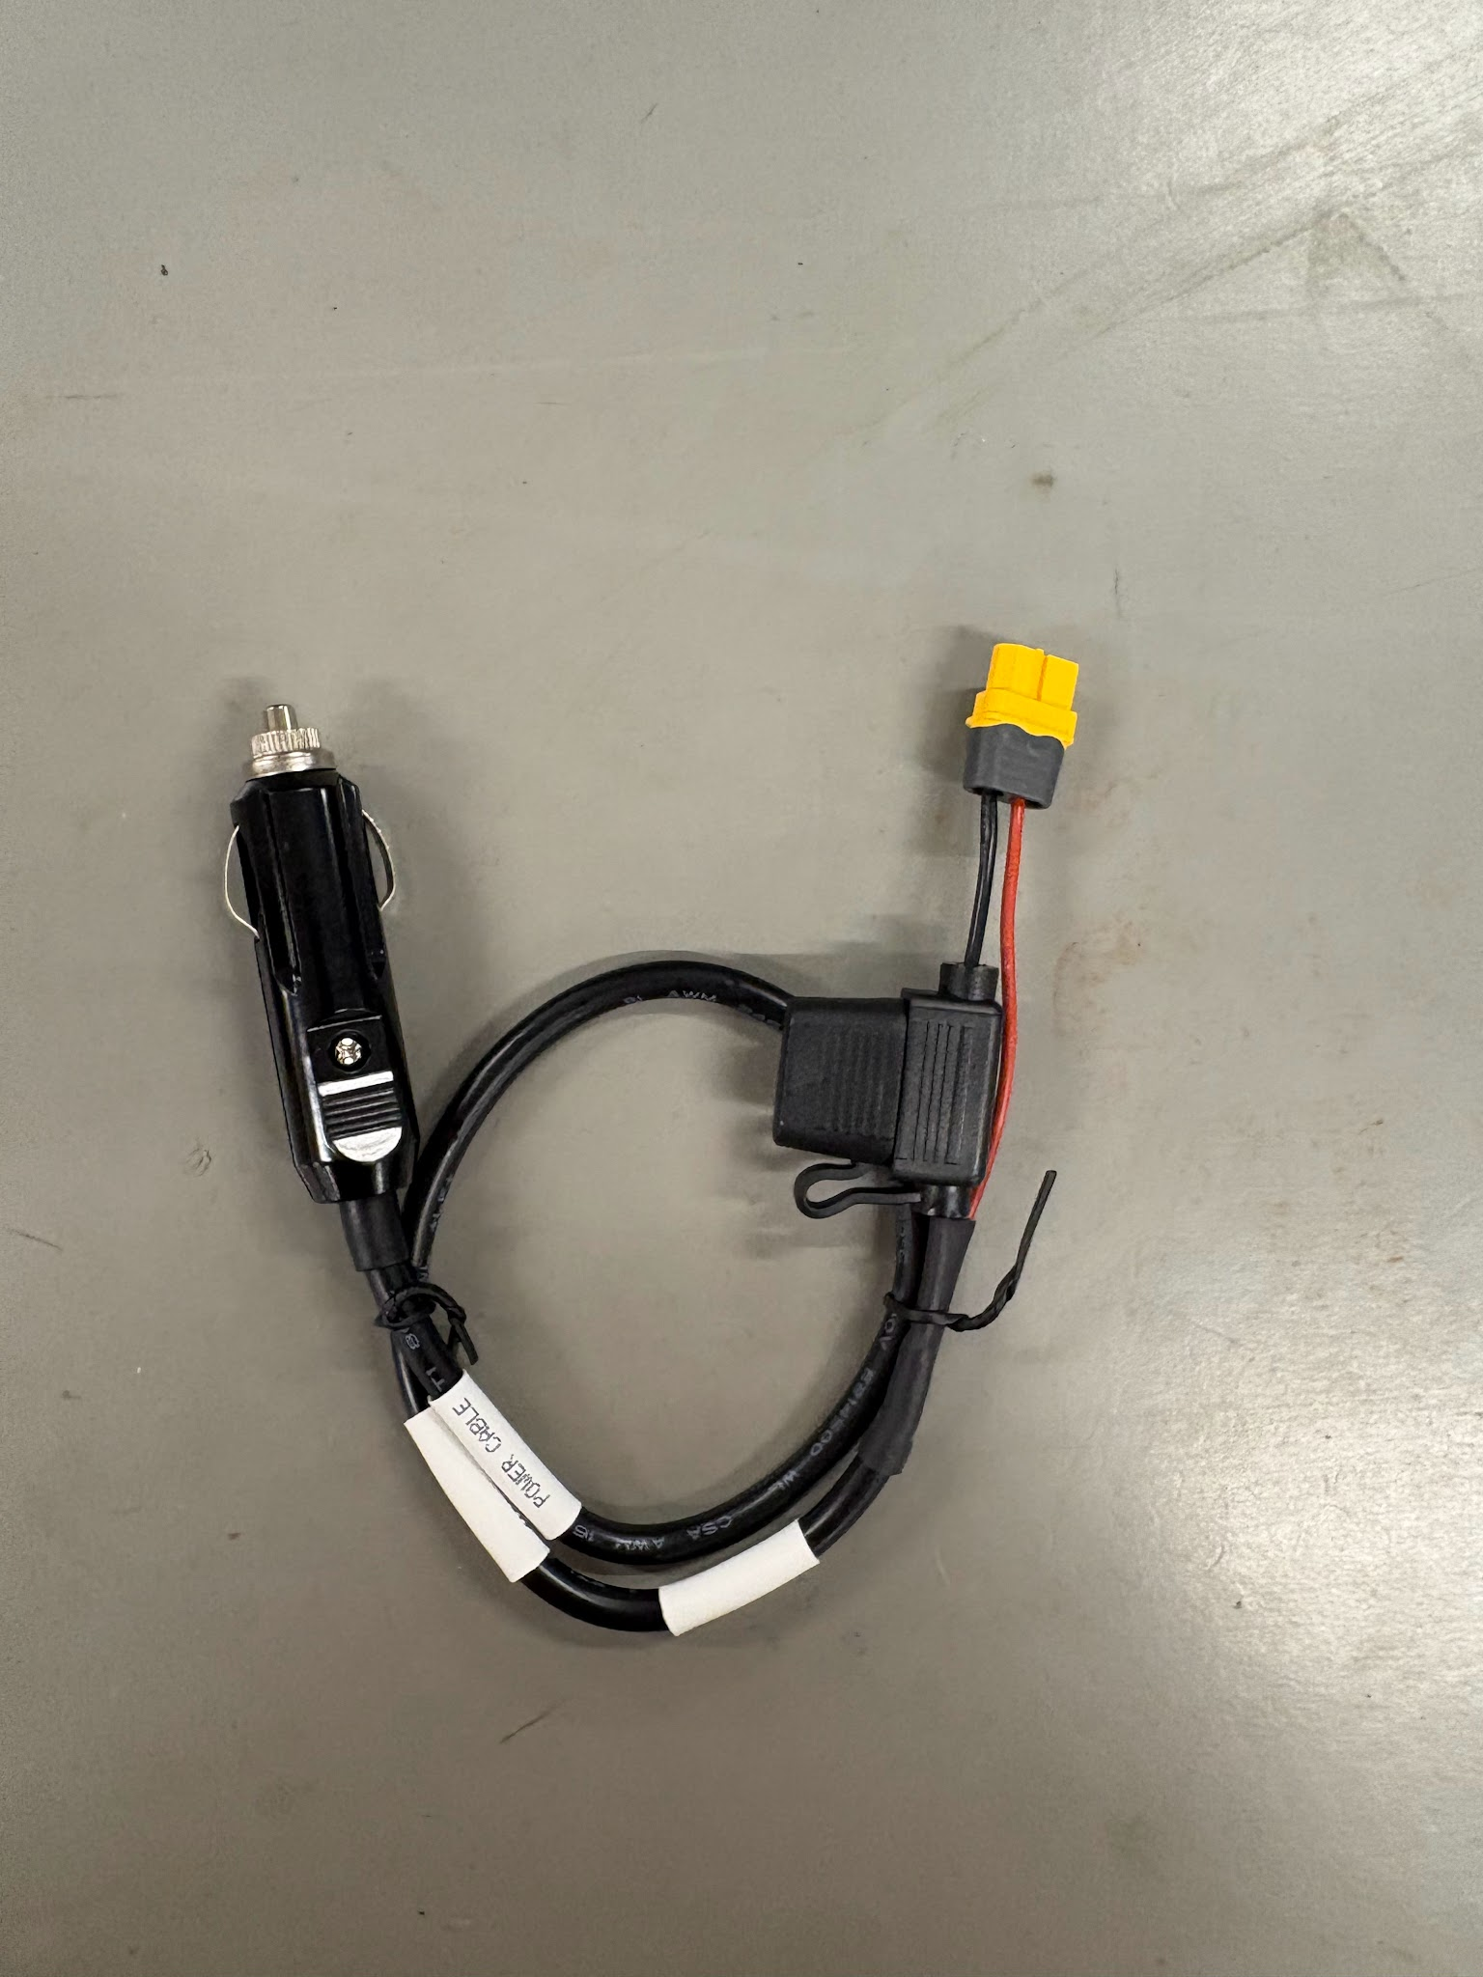
Temporary Cigarette Power

Slide 33
Next Steps
After all components are mounted and cables are secured please complete a mid point inspection
Ensure all components are secured correctly
Cables are secured with zipties and all tails are cut flush
The machine can move throughout all geometry positions with no cable snags
Check for rub points on cabling
System power on and GPS initializes

Slide 34
Calibration

Slide 35
Calibration Prep
At this point in the installation all components should be installed and working correctly
All cabling should be secured and inspected
Machine should be put back together
System should be initialized
Gather tools required to perform a calibration
Tape measure
Level
Plumb Bob
Framing Square

Slide 36

How to access Calibration Wizard

Slide 37
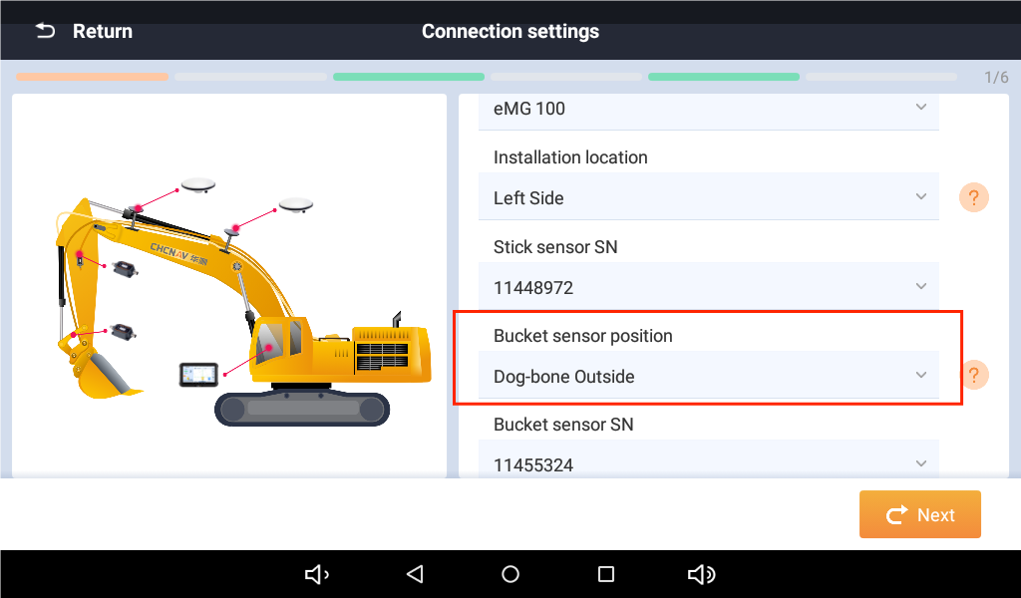
Configuration Setup
This section is how we configure the sensor orientation, system type, the location and mounting orientation of the sensors.
You will need to know which sensor serial number is installed at each location

Slide 38
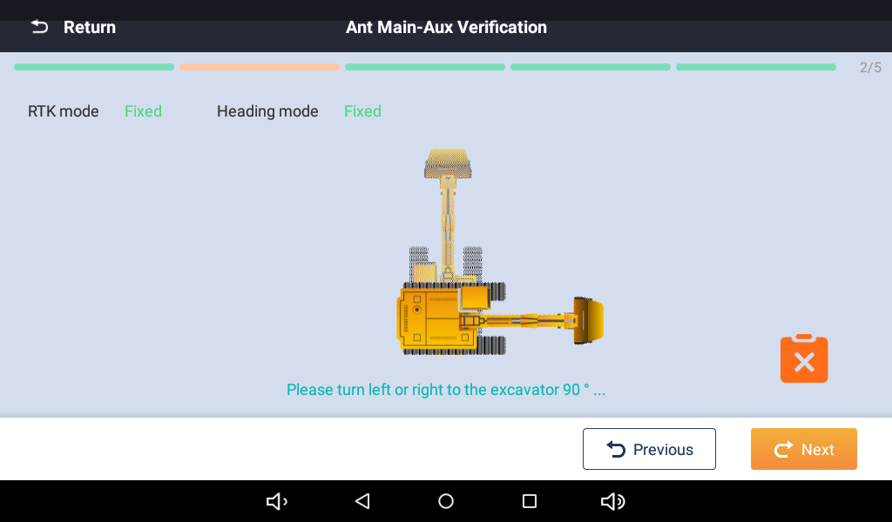
Antenna Orientation Check
The orientation check ensures that we have connected the Aux and Main antennas in the correct port on the display. This involves turning the machine roughly 90°
If this step fails switch the Aux and Main Antenna cables

Slide 39
Machine Dimensions
Consist of 5 key measurements the measurement need to be precise to ensure the machine perform correctly and within tolerance. Any error here will affect the overall machine performance. It is best to double check measurements and measure to the smallest unit possible for this step.
Measurement needed are O-M, O-P, N1, N2, P-D
  O-M and O-P is measured using the framing square
    O is a ‘virtual” point that used to calculate the hypotenuse of the of the triangle O-M and O-P creates
    N1 and N2 is the width of the boom underneath both antennas
      N1 is the front antenna
    P-D is the distance between the stick and bucket pin

Slide 40
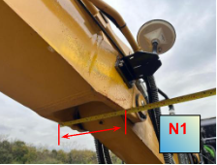
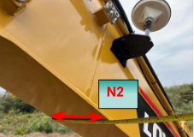
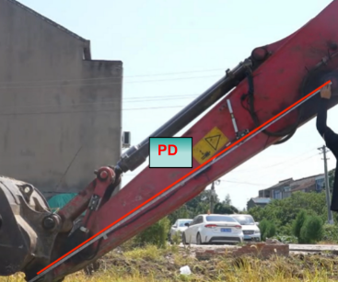

Slide 41
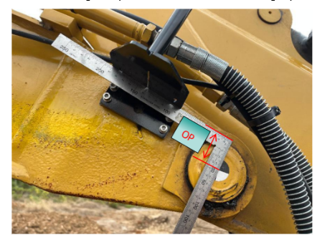
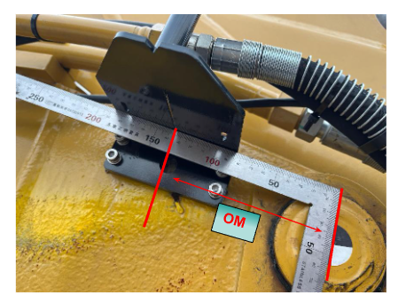
OM-OP

Slide 42
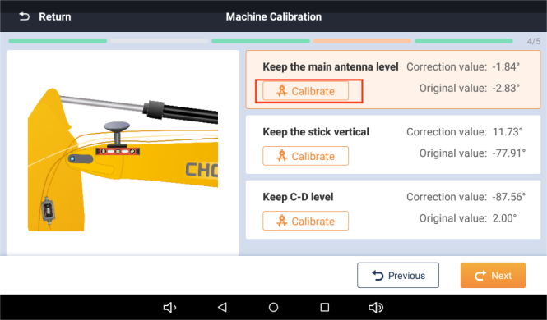
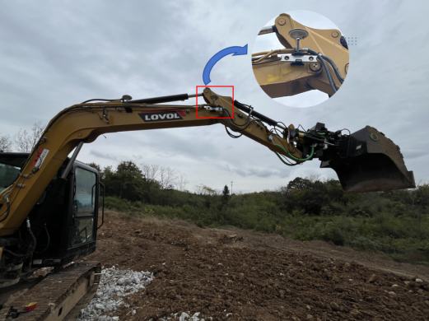
Sensor Calibration
The process calibrates the GNSS antenna, Stick Sensor, and Bucket Sensor. You will need a magnetic level and plumb bob for this process.
GNSS antenna
  The magnetic level is mounted underneath the Main Antenna bracket(Front)
  Position the machine so that level is reading level
  Press calibrate

Slide 43
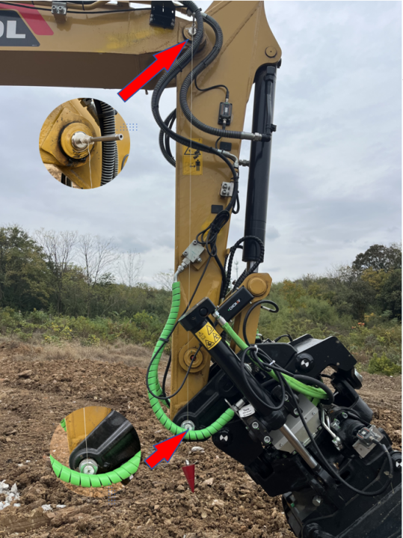
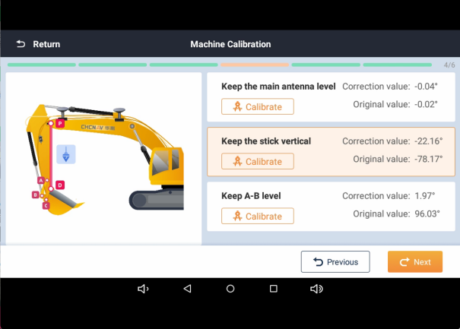
Sensor Calibration
The stick sensor will need to be in a vertical position for this routine. We will use a plumb bob to establish a vertical line for the stick to the bucket pin.Ensure nothing is preventing the plumb bob from freely hanging.

Slide 44
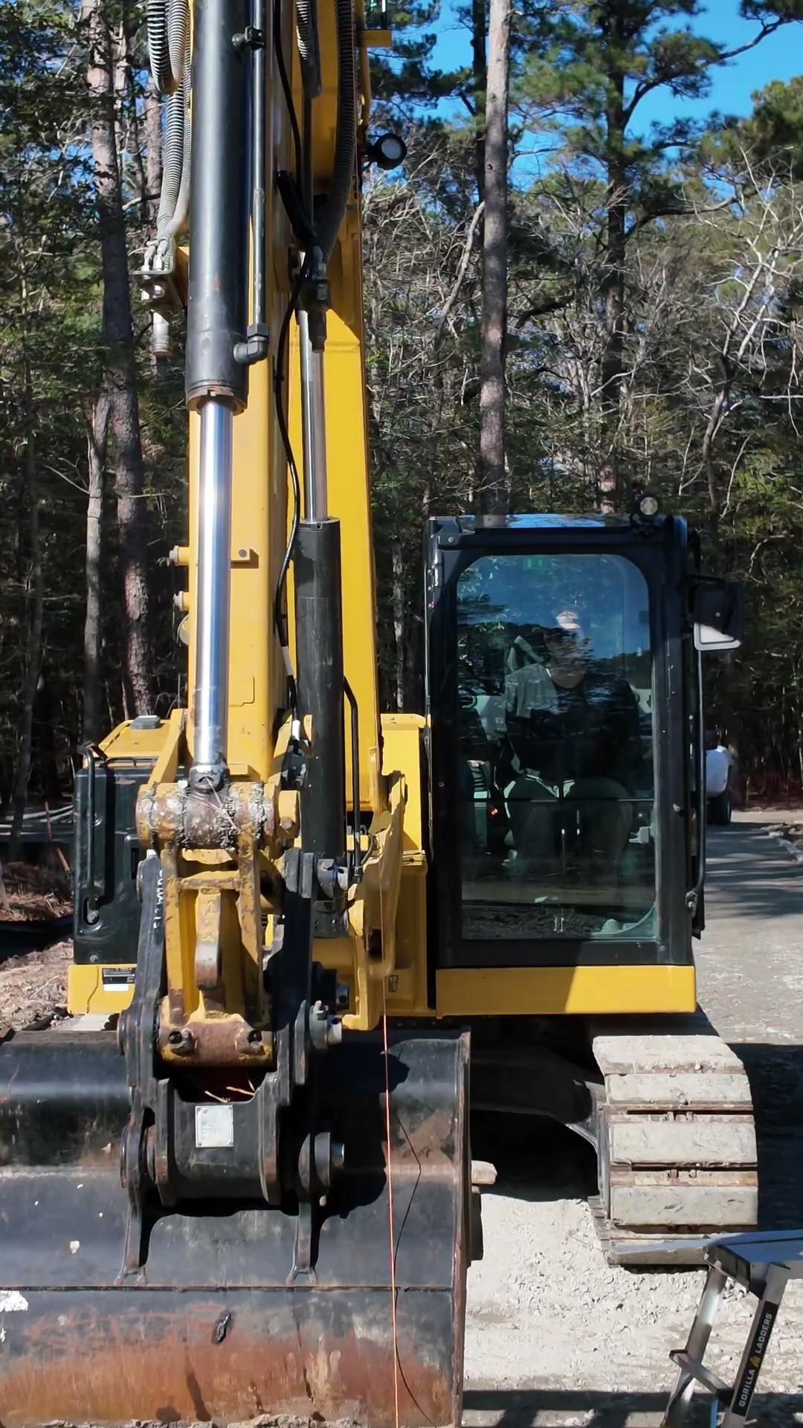

Slide 45
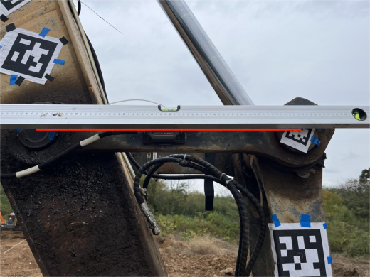
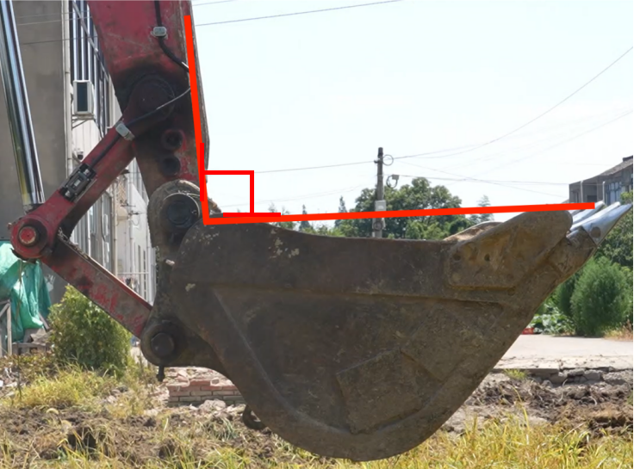
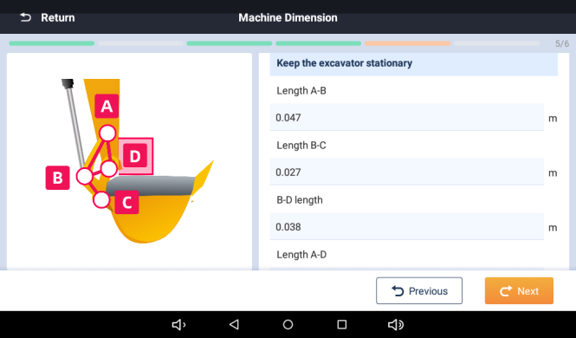
Bucket Sensor Calibration(DogBone)
The bucket calibration process requires setting sensor level and collecting 5 measurements.
  Use a level to get the dogbone horizontal to perform the sensor calibration
We need to collect the following 5 measurements. Before collection the measurements the bucket must be oriented roughly 90 degrees
The measurements are :
  A-B
  B-C
  B-D
  A-D

Slide 46
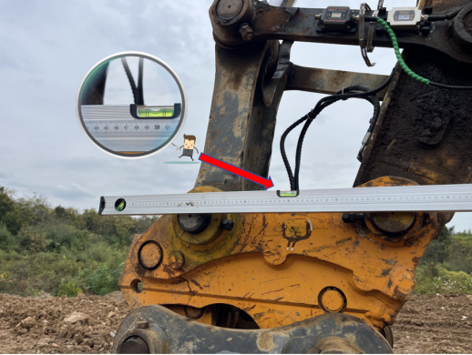
Bucket Sensor Calibration(Quick Coupler)
If the bucket sensor is installed inside of the quick coupler the process is similar to the dog bone calibration but the dogbone measurements are not required.
To complete the bucket sensor calibration we will use a level to get C-D horizontal

Slide 47
Bucket Calibration
Most systems support multiple buckets, while on site we will need to calibrate all the buckets that goes with the machine.
Calibrating a bucket requires a few measurements and positioning the bucket in two different positions to set the sensor values.
Bucket naming is important so the operator will be able to identify them later.
Typically naming them the bucket width will work for this
The system support two bucket types a regular bucket and custom irregular shaped bucket.
The custom function is used for a v-shaped bucket or similar

Slide 48
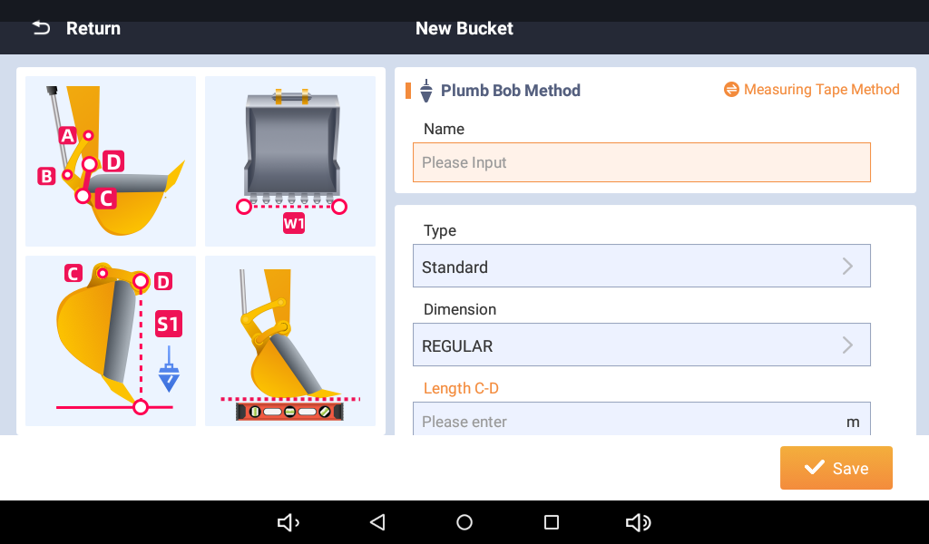
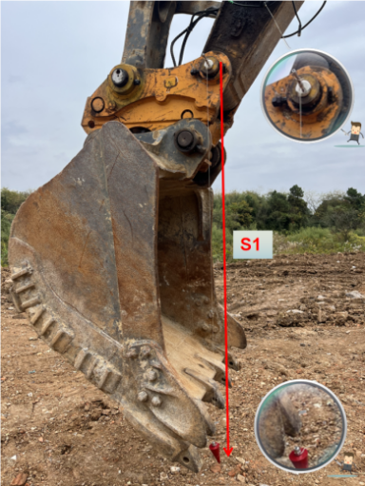
Bucket Calibration Process
We will need a level, plumb bob, and tape measure for this process.
The process involves getting the bucket teeth plumb with bucket pin and we will also have to get the bottom of the bucket level at the end.
We will also need to collect the bucket width, height, and if the sensor is on the dogbone we will have to measure C-D
  W1 is measured at the widest point of the bucket
  S1 is measured from the pin to the tooth plane when the bucket is plumb

Slide 49
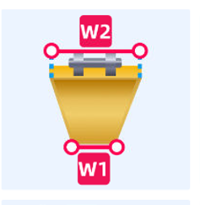
Custom Buckets
If the customer has an irregular bucket for example a ditching bucket. We can change add a measurement within the calibration process to accommodate this bucket.
The calibration process is the same but we will have to measure W2 which is the top width of the bucket and W1 is the bottom width of the bucket.

Slide 50
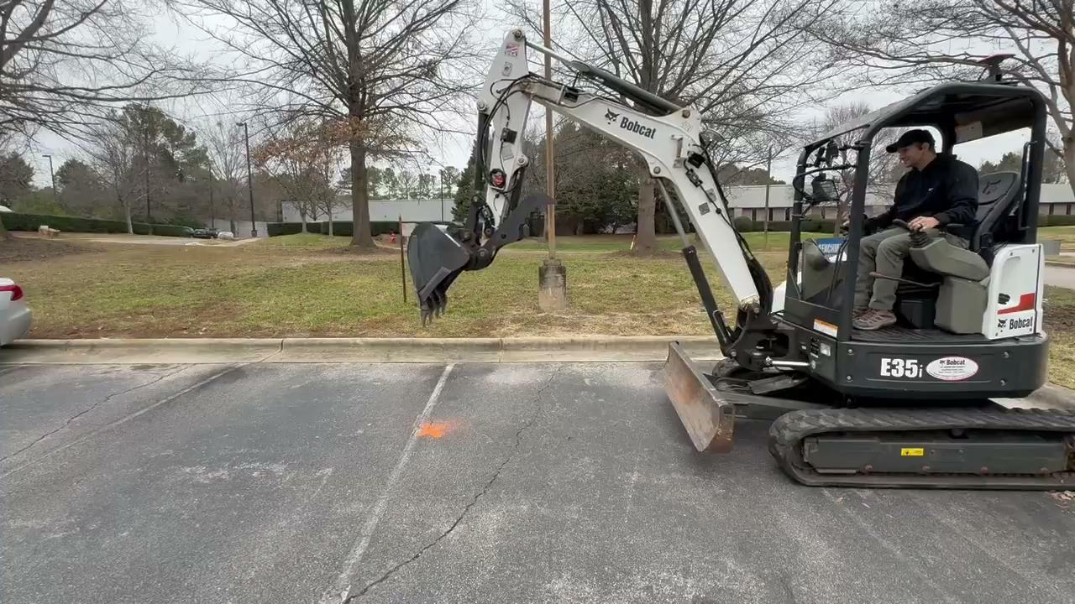
Machine Verification
Utilize a flat plane surface and a marked point on the ground to ensure machine is measuring correctly
Check machine against the fixed point in the following order
  Flat to Vertical
  Far vs Close
  Compass Check

Slide 51
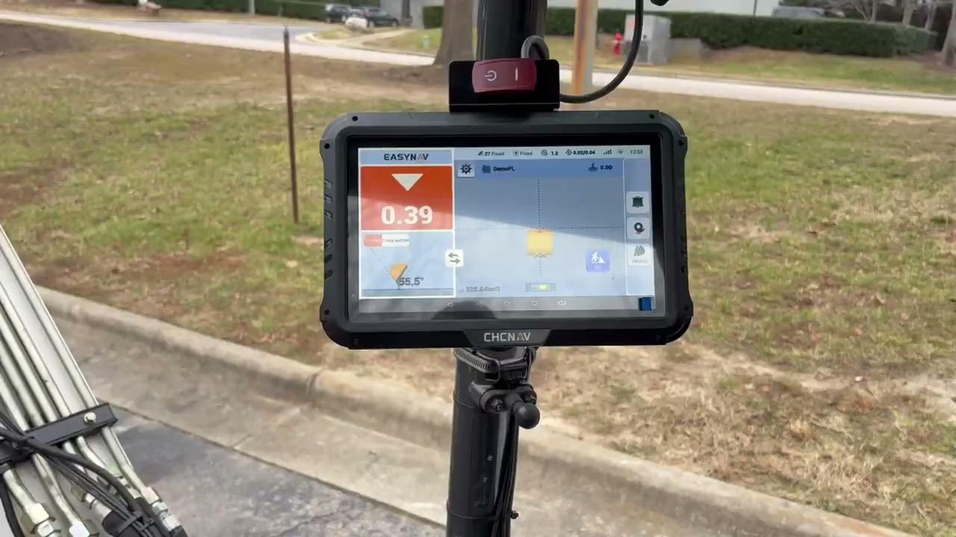

Slide 52
Machine backup

Slide 53
Basic Troubleshooting
Calibration Issues
  Tape measure Check
    Would indicate sensor or measurements
  Flat to vertical inaccurate
    Points to bucket sensor issues
  Far vs close inaccurate
    Indicates a stick or GPS issues

Slide 54
Basic Troubleshooting
Radio Issues
  Common cause are incorrect login information for the network
  No cellular data on machine display
  Incorrect radio setting on radio
  Base station not broadcasting
No GPS Fix (non-Radio)
  Machine antenna issue
  Antenna does not have clear sky visibility

Slide 55
Do’s and Don'ts
Hot engine components
Pinch/Rub Points
Master ground for welding
Operator seat movement
Beware of bucket movements some bucket may make contact with machine
Verify unit of measurement before calibrating
Check smart level operation

Slide 56
Process and Paperwork

