Slide 1
How to Train a Customer
Onsite training after installation

Slide 2
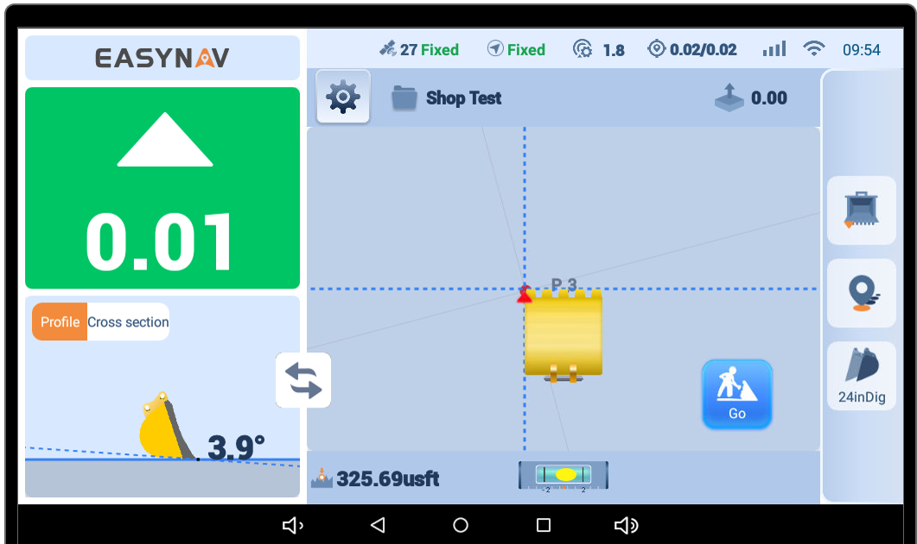
Introduce the operator to the User Interface (Screen Layout)
(Doing this step first helps them understand the function and layout quickly)
Time spent: Average of 10 minutes
Explain that the screen is broken down into three main windows
Upper Left (Cut/Fill)
Bottom Left (Front/Side view of Bucket)
Main View (Top down view of Machine)
Changes Views from small corner to large View
1
3
1
2
3
2
4
4

Slide 3
Afterwards I explain the rest of the screen icons and functions.
I start at the top of the screen and go clockwise. Once I get to each menu icon I try to give a brief description of it and the use of it without distracting from the entire layout
1
1
Data Bar (Connection Information)
Function Buttons
Tooth Indicator Record Points Change Buckets
Real Time Elevation reading & Slope
Menu to open up Surfaces (Infield Design)
4
2
2
1
2
3
1
3
2
4
3
3

Slide 4
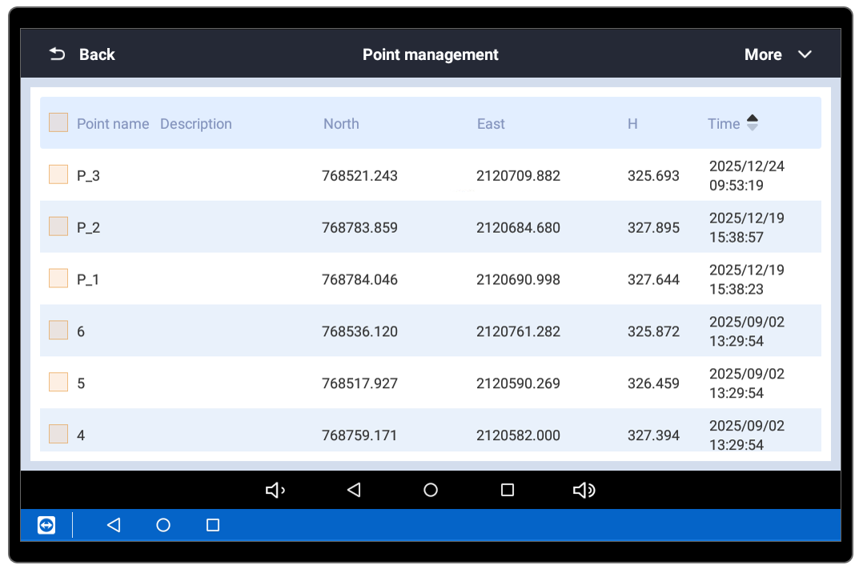
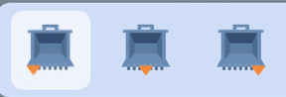
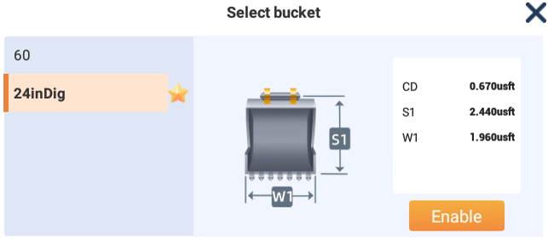
Function Button Deep Dive
2
Function Buttons
Tooth Indicator Record Points Change Buckets
2
1
2
3
1
2
1
3
2
3

Slide 5
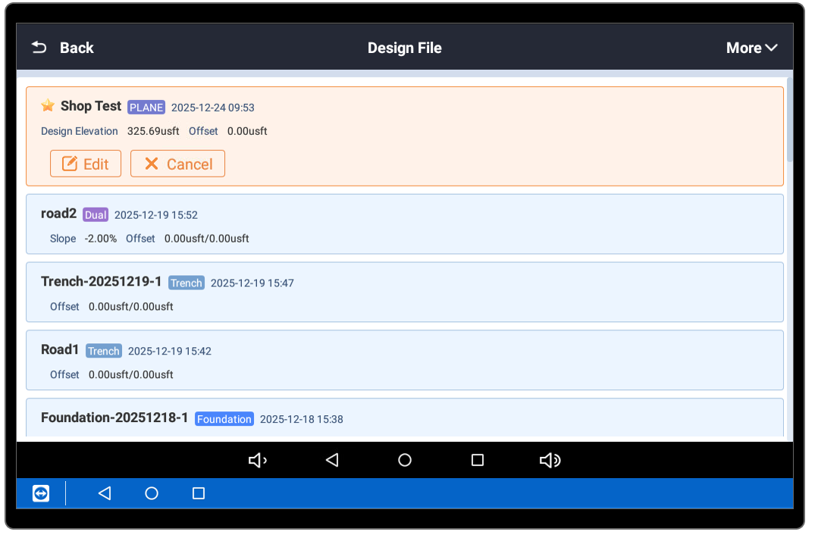
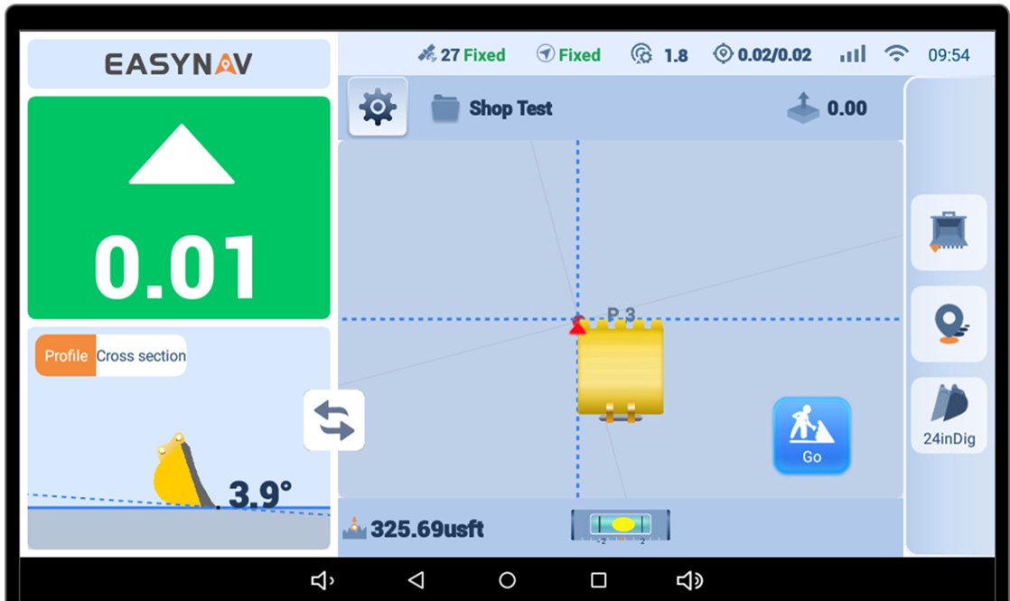
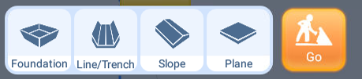
Surface Design Deep Dive
This opens up all the infield design surfaces that have been created
4
4
This opens up all the infield design surfaces that have been created
5
5

Slide 6
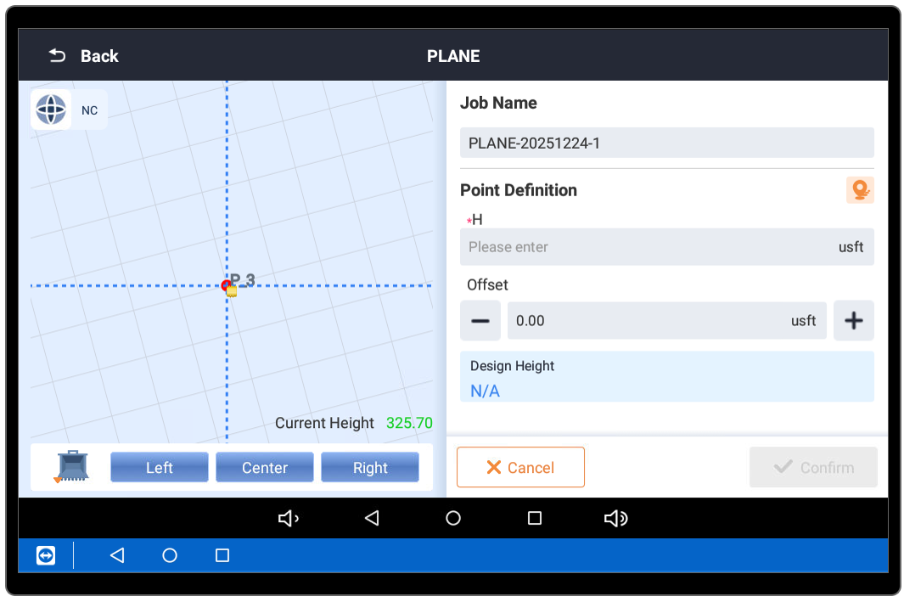
How to Create a Flat Plane Surface
The purpose of this is to SET a single Elevation point as your design. You cut and fill indicator will be telling you where to dig to until you get to that SET elevation number. It will make you pad, or trench, or active surface a flat level surface to that SET elevation
Click the “Go” button and select “Plane”
2 Ways to record a design elevation
1: With bucket tooth
2: With pre-recorded point
2
Opens this page
1

Slide 7
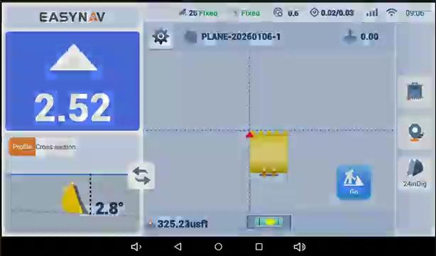
Design: Flat Surface (From bucket)

Slide 8
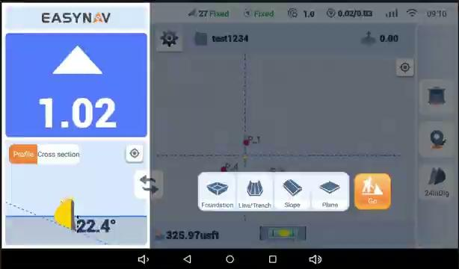
Design: Flat Surface (From recorded point)

Slide 9
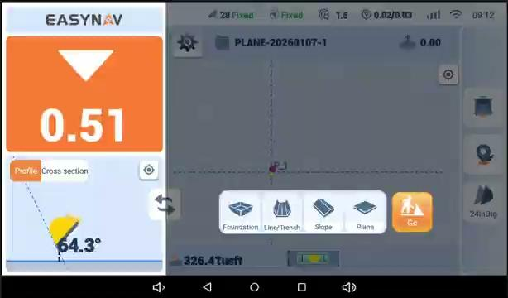
Design: Slope

Slide 10
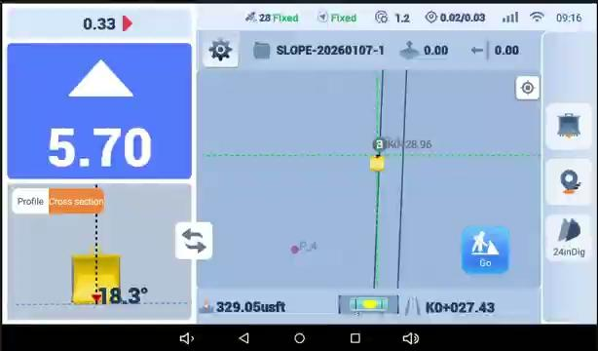
Design: Line/Trench
With Vertical Offset

Slide 11
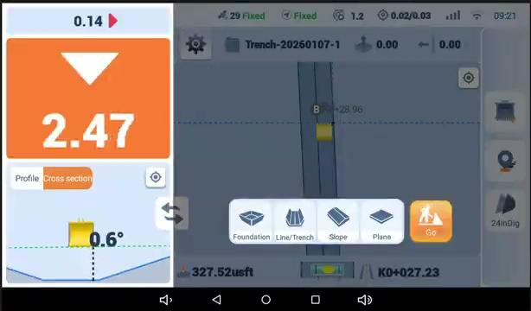
Design: Foundation

Slide 12
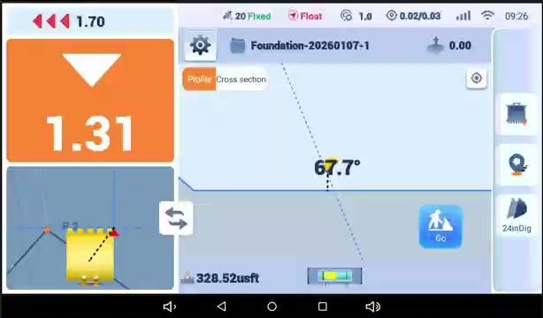
Design: Switching Designs

Slide 13
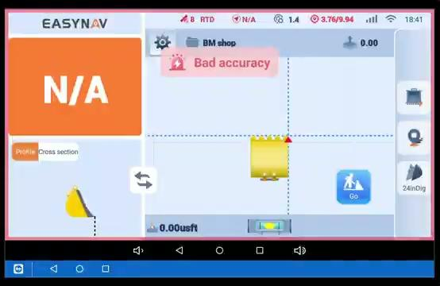
Settings:

