Slide 1
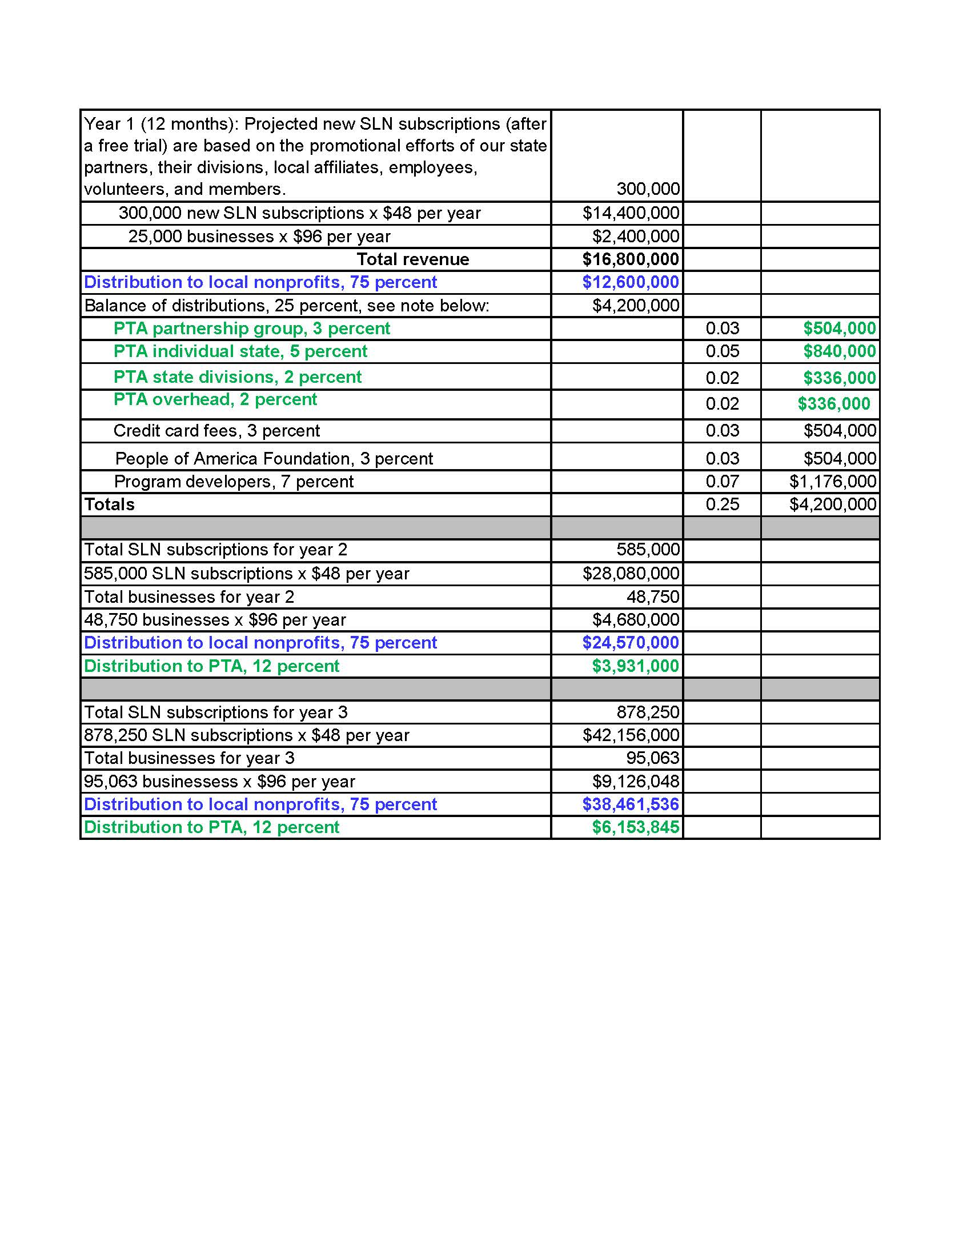
Income distribution:
We have projected annual revenue from individual Social Legacy Network (SLN) subscriptions and business/professional service provider membership fees generated by our partner and their members. We anticipate a 25 percent annual increase in new members and businesses, with a 70 percent yearly renewal rate in both categories.

